Slide 1
Leonardo Executive Learning Journey SUSTAINABILTY CONTROL SYSTEMS
Imperial College
Business School
Leonardo
Centre
21 May 2021
Funded by
Strand delivered by

Slide 2
Sustainability Control Systems
Today’s agenda
ESG and the SDGs
B Corporations
Setting Net Zero targets
External ESG assessment
Investor perspective
Supply chain perspective: Ecovadis
Q & A/ Reflection questions
Suggested readings for the week
Discussion
Imperial College
Business School
Leonardo
Centre

Slide 3
What are Environmental, Social, and
Governance (ESG) criteria?
Environmental, social, and governance (ESG) criteria are a set of standards for a company’s operations that socially conscious investors use to screen potential investments.
Environmental criteria consider how a company performs as a steward of nature.
Social criteria examine how it manages relationships with employees, suppliers, customers, and the communities where it operates.
Governance deals with a company’s leadership, executive pay, audits, internal controls, and shareholder rights.
Imperial College
Business School
Leonardo
Centre

Slide 4
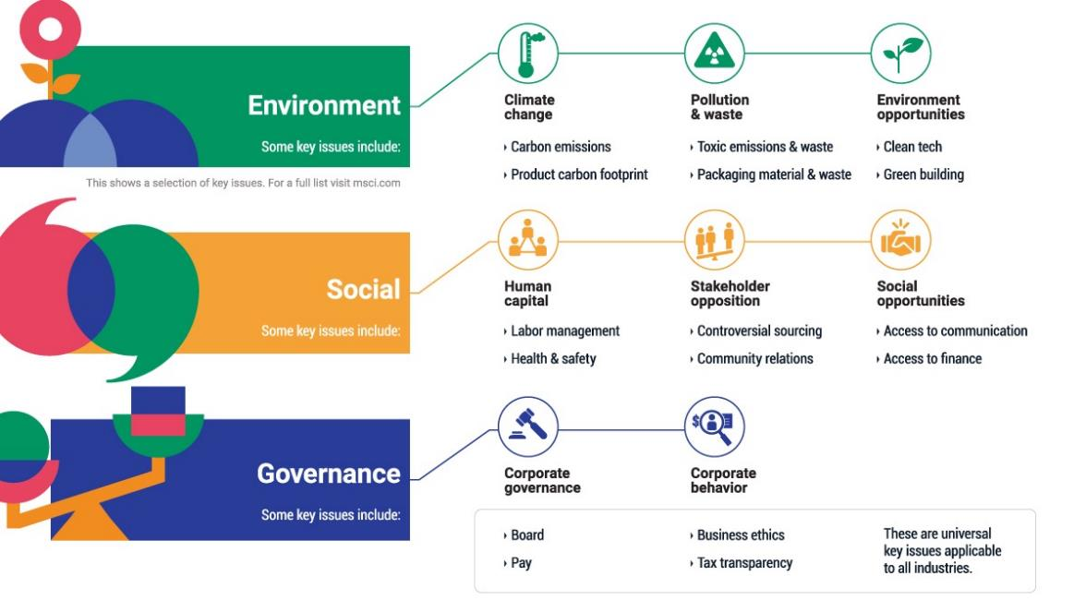
Calculating Rating
Imperial College
Business School
Leonardo
Centre

Slide 5
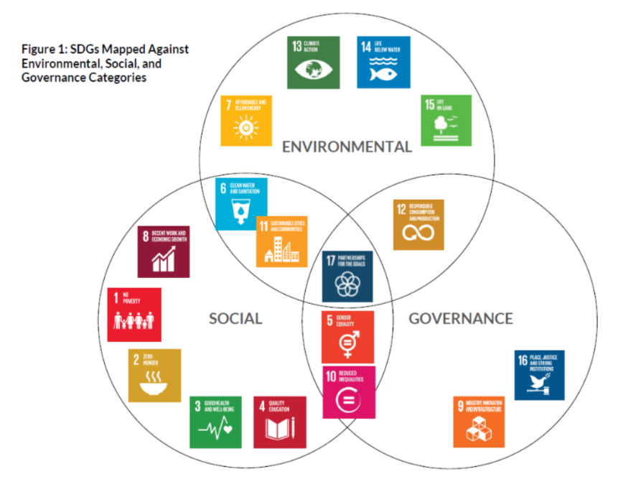
ESG vs SDG
Imperial College
Business School
Leonardo
Centre

Slide 6
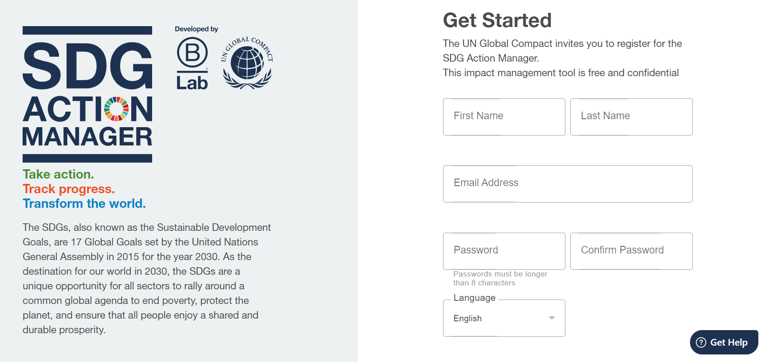
SDG Action Manager
Imperial College
Business School
Leonardo
Centre
https://app.bimpactassessment.net/get-started/partner/ungc

Slide 7
Sustainability Control Systems
Today’s agenda
ESG and the SDGs
B Corporations
Setting Net Zero targets
External ESG assessment
Investor perspective
Supply chain perspective: Ecovadis
Q & A/ Reflection questions
Suggested readings for the week
Discussion
Imperial College
Business School
Leonardo
Centre

Slide 8
B Corporations
The B Corp Declaration of Interdependence
We envision a global economy that uses business as a force for good.
This economy is comprised of a new type of corporation - the B Corporation - Which is purpose-driven and creates benefit for all stakeholders, not just shareholders.
As B Corporations and leaders of this emerging economy, we believe:
That we must be the change we seek in the world.
That all business ought to be conducted as if people and place mattered.
That, through their products, practices, and profits, businesses should aspire to do no harm and benefit all.
To do so requires that we act with the understanding that we are each dependent upon another and thus responsible for each other and future generations.
Imperial College
Business School
Leonardo
Centre

Slide 9
B Corporations
Local examples
In progress
Imperial College
Business School
Leonardo
Centre

Slide 10
B Corporations
The process
B Impact Assessment (BIA) is a free, online platform that evaluates how your company interacts with your workers, customers, community, and environment. Complete and submit the BIA to begin the performance requirement of certification.
Legal Requirement Tool to determine how your company can integrate stakeholder consideration into your governance structure. Your company's specific legal requirement and timeline will depend on location and structure.
After completing the BIA, B Lab will verify your score to determine if your company meets the 80-point bar for certification. Meet virtually with B Lab staff to review your completed B Impact Assessment and submit confidential documentation to validate your responses. To maintain certification, B Corps update their BIA and verify their updated score every three years.
Imperial College
Business School
Leonardo
Centre

Slide 11
Sustainability Control Systems
Today’s agenda
ESG and the SDGs
B Corporations
Setting Net Zero targets
External ESG assessment
Investor perspective
Supply chain perspective: Ecovadis
Q & A/ Reflection questions
Suggested readings for the week
Discussion
Imperial College
Business School
Leonardo
Centre

Slide 12
B Corporations
Setting your emissions boundary
PAS 2060: Specification For The Demonstration Of Carbon Neutrality
Published by the British Standards Institution (BSI), PAS 2060 provides a common definition and a method of validation for carbon neutrality.
The carbon emissions boundary should include 100% of Scope 1 and Scope 2 emissions, and all Scope 3 emissions that contribute more than 1% of the total footprint.
It requires an organisation to develop a carbon management plan that defines specific targets for reductions, a time scale, the measures that will reduce emissions, and how residual emissions will be offset.
Source: Net Zero: An introduction for business, Carbon Intelligence/ HSBC
Imperial College
Business School
Leonardo
Centre

Slide 13
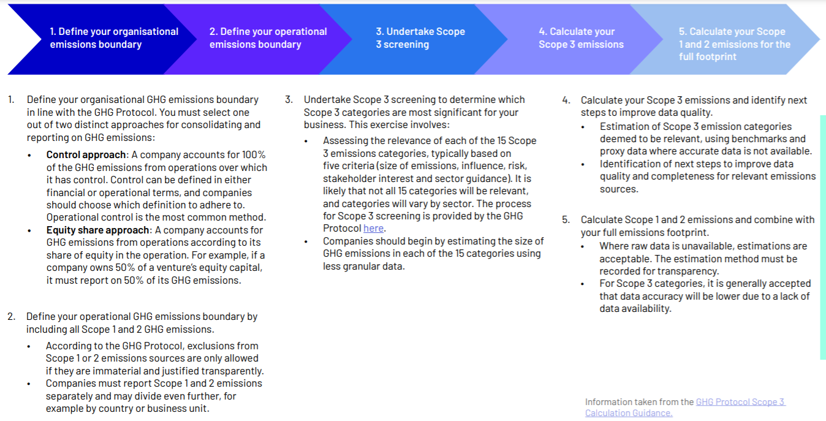
B Corporations
Setting your emissions boundary
Imperial College
Business School
Leonardo
Centre
Source: Net Zero: An introduction for business, Carbon Intelligence/ HSBC

Slide 14
B Corporations
What should your emissions reduction pathway look like?
The priority for a net zero strategy is to reduce Scope 1 and 2 emissions on an absolute basis as fast as possible, followed by engagement with your organisation's supply chain and customers to reduce Scope 3 emissions.
The SBTi recommends organisations to set net zero carbon targets that are consistent with limiting warming to well below 2°C, and pursue efforts to limit to 1.5°C degrees.
The distinction between a 1.5°C world and a 2°C world might sound minor but in terms of the numbers of people and wildlife that will be affected, the consequences of the additional 0.5°C will be vast.
The SBTi website has an abundance of resources and guidance documents designed to assist companies throughout the process. A key Excel document is the 'science-based target setting tool', which helps organisations to determine target milestone years by aligning with a science-based reduction pathway. Download this Excel tool.
An emissions reduction strategy should project future emissions based on expected changes to the organisation, and the measures that can be taken to reduce emissions. When defining the emissions reduction pathway, it is important to confirm if you will take a location or market-based approach to reporting on Scope 2 emissions as this will influence the strategy.
Imperial College
Business School
Leonardo
Centre
Source: Net Zero: An introduction for business, Carbon Intelligence/ HSBC

Slide 15
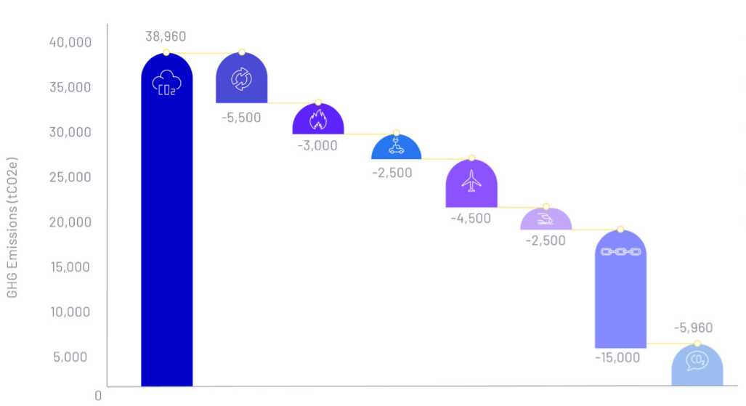
B Corporations
What should your emissions reduction pathway look like?
Example…
Imperial College
Business School
Leonardo
Centre

Slide 16
B Corporations
What should your emissions removal pathway look like?
Once the emissions reduction pathway has been defined, the extent of carbon removals required to balance remaining emissions to zero will become clear. The overall ambition of your strategy, and the cost and quality of reduction or removal choices are key factors in choosing which year to aim for net zero.
The SBTi recommends that the use of removals is limited to balancing the impact of residual emissions as per 1.5°C consistent scenarios with no or limited overshoot.
Organisations should be clear on which emissions sources cannot be removed and therefore should be balanced, as this will affect the integrity of the strategy. It is more credible, for example, to offset emissions from air travel than from electricity consumption as zero carbon air travel is not commercially available.
Consider both offsetting and insetting when designing a carbon removals strategy.
Offsetting is where a company purchases credits from an external offsetting partner.
Insetting is where a company invests in carbon removal projects within its own value chain. For example, the luxury fashion retailer, Burberry, invests in methods to improve carbon capture on farms run by their wool producers in Australia.
Companies that have land related activities in their value chain should prioritise insetting over purchasing offsets.
Imperial College
Business School
Leonardo
Centre
Source: Net Zero: An introduction for business, Carbon Intelligence/ HSBC

Slide 17
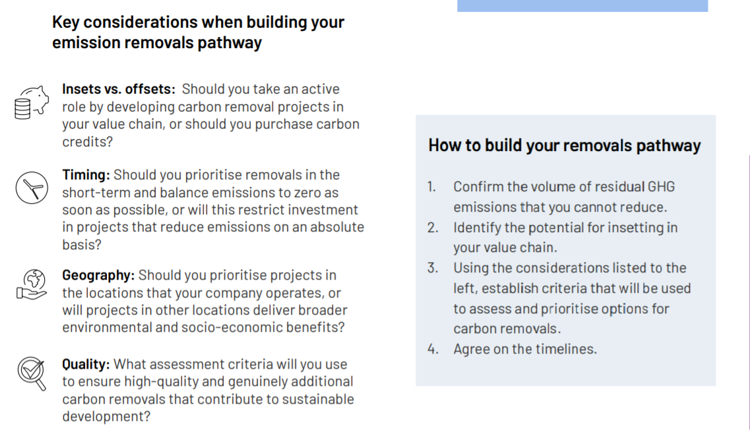
B Corporations
What should your emissions removal pathway look like?
Imperial College
Business School
Leonardo
Centre
Source: Net Zero: An introduction for business, Carbon Intelligence/ HSBC

Slide 18
Sustainability Control Systems
Today’s agenda
ESG and the SDGs
B Corporations
Setting Net Zero targets
External ESG assessment
Investor perspective
Supply chain perspective: Ecovadis
Q & A/ Reflection questions
Suggested readings for the week
Discussion
Imperial College
Business School
Leonardo
Centre

Slide 19
Sustainable Investment in US
Imperial College
Business School
Leonardo
Centre

Slide 20
MSCI Rating Distribution
Imperial College
Business School
Leonardo
Centre

Slide 21
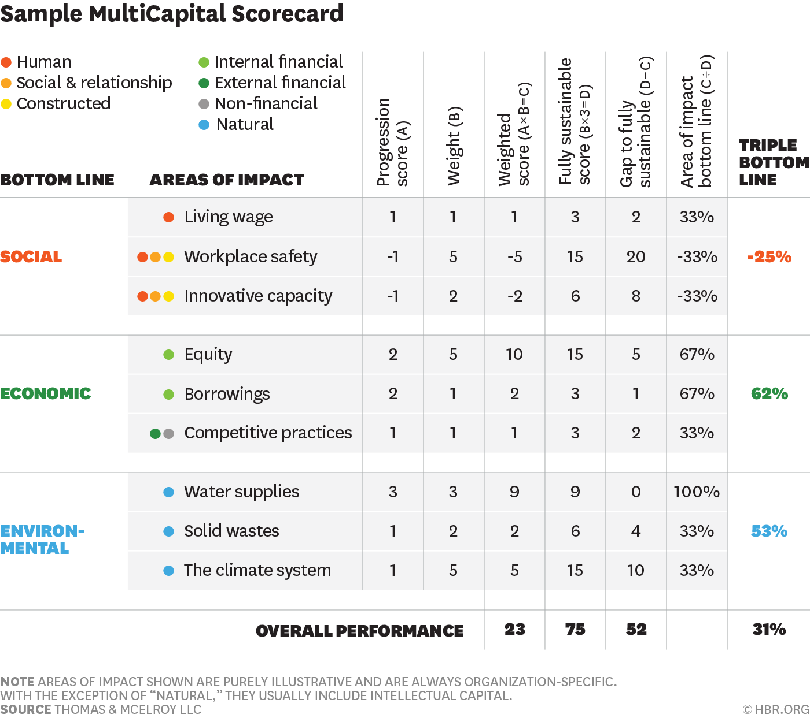
Sample of rating calculation
Imperial College
Business School
Leonardo
Centre

Slide 22
ESG Balance Scorecard
Imperial College
Business School
Leonardo
Centre

Slide 23
ESG investment
Imperial College
Business School
Leonardo
Centre

Slide 24
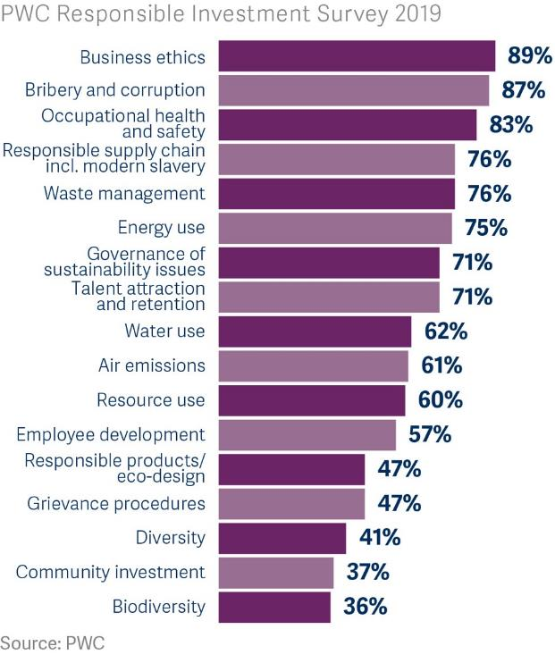
ESG issues for PE investment decision
Imperial College
Business School
Leonardo
Centre

Slide 25
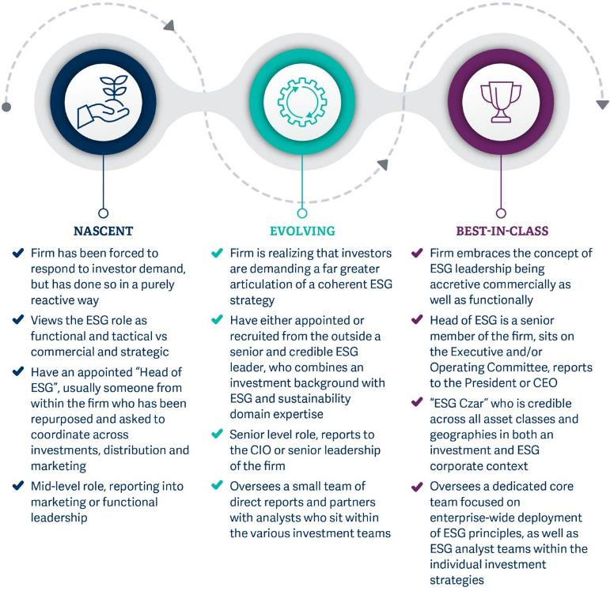
ESG maturity model
Imperial College
Business School
Leonardo
Centre

Slide 26
Sustainability Control Systems
Today’s agenda
ESG and the SDGs
B Corporations
Setting Net Zero targets
External ESG assessment
Investor perspective
Supply chain perspective: Ecovadis
Q & A/ Reflection questions
Suggested readings for the week
Discussion
Imperial College
Business School
Leonardo
Centre

Slide 27
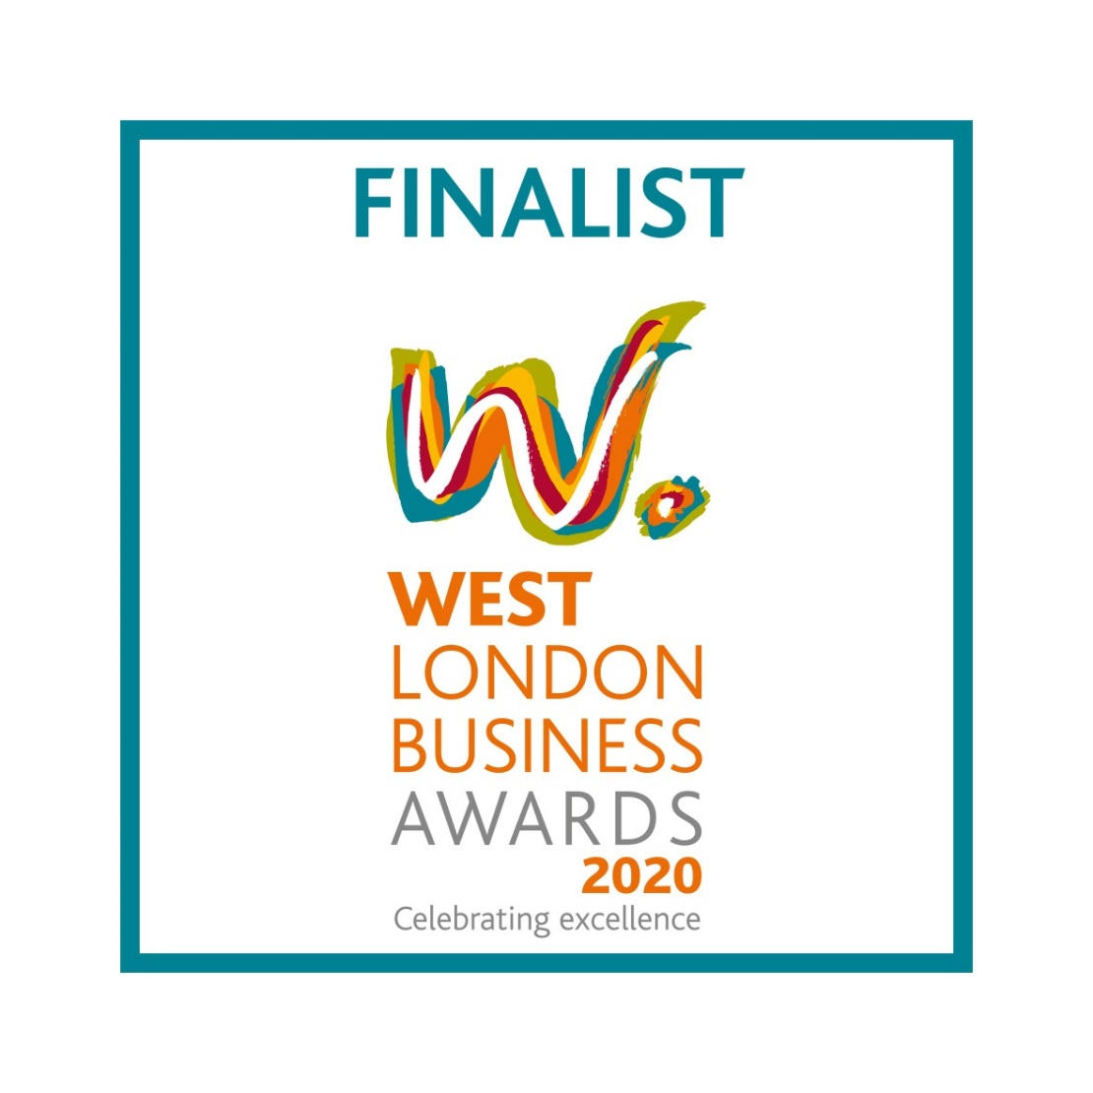
https://www.wrapology.com
“Annual Ecovadis assessment by Wrapology’s clients provided additional impetus to their environmental sustainability journey” – Andrew Dakers, WLB Awards judge
Imperial College
Business School
Leonardo
Centre

Slide 28
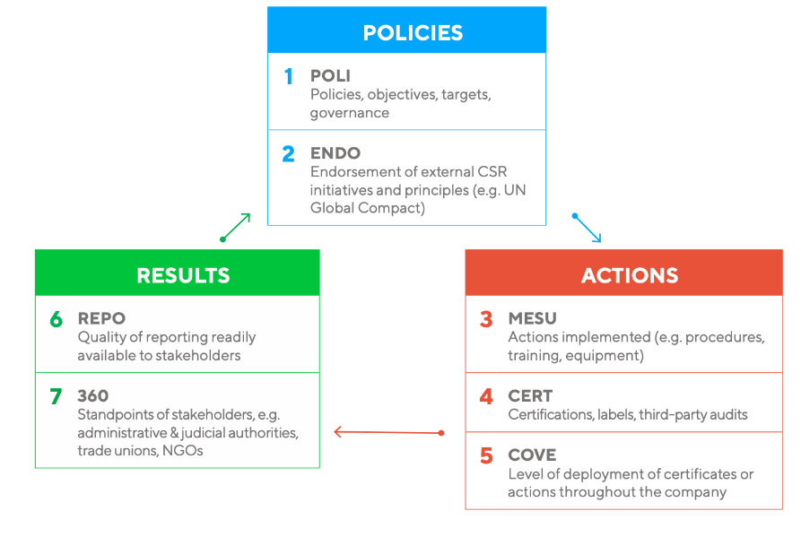
Ecovadis model
Imperial College
Business School
Leonardo
Centre

Slide 29
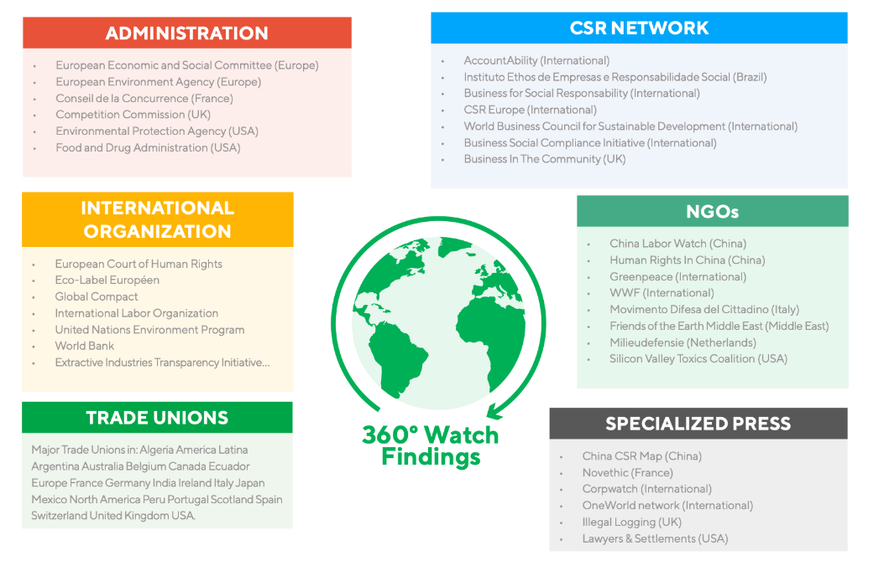
Ecovadis sources
Imperial College
Business School
Leonardo
Centre

Slide 30
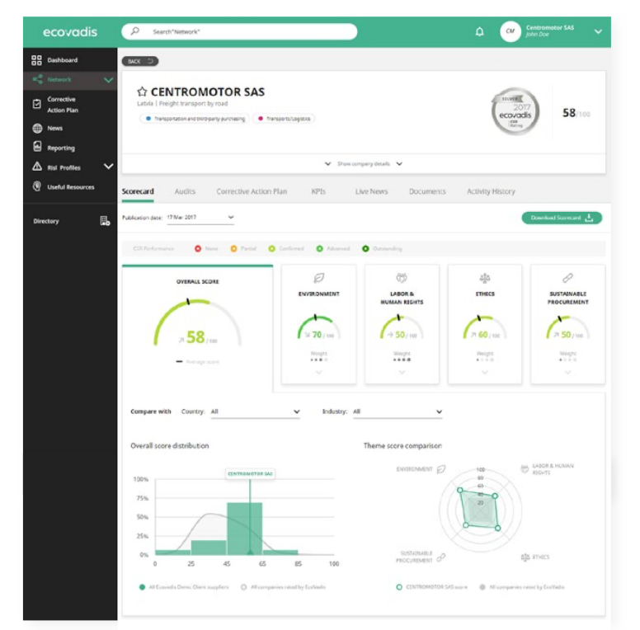
Ecovadis output
Imperial College
Business School
Leonardo
Centre

Slide 31
Sustainability Control Systems
Today’s agenda
ESG and the SDGs
B Corporations
Setting Net Zero targets
External ESG assessment
Investor perspective
Supply chain perspective: Ecovadis
Q & A/ Reflection questions
Suggested readings for the week
Discussion
Imperial College
Business School
Leonardo
Centre

Slide 32
Qs & As ?

Slide 33
Reflection questions
What control systems do you have actually in place already? (environmental, social, governance related)
What works – what doesn’t? (success stories and barriers)
How is your thinking developing on setting NET ZERO boundaries, reduction and removal pathways?

Slide 34
Sustainability Control Systems
Today’s agenda
ESG and the SDGs
B Corporations
Setting Net Zero targets
External ESG assessment
Investor perspective
Supply chain perspective: Ecovadis
Q & A/ Reflection questions
Suggested readings for the week
Discussion
Imperial College
Business School
Leonardo
Centre

Slide 35
Suggested readings for the week
Perego, P. and Hartmann, F. (2009), “Aligning performance measurement systems with strategy: the case of environmental strategy”, Abacus, Vol. 45 No. 4, pp. 397-428
Meet 8 of the UK’s Most Sustainable Companies in 2020, Hubble HQ, 1 March 2021, https://hubblehq.com/blog/sustainable-companies-uk
Top 25 'Green' Companies in the UK, TalentPool https://talentpool.com/blog/top-25-green-companies-in-the-uk

Slide 36
Sustainability Control Systems
Today’s agenda
ESG and the SDGs
B Corporations
Setting Net Zero targets
External ESG assessment
Investor perspective
Supply chain perspective: Ecovadis
Q & A/ Reflection questions
Suggested readings for the week
Discussion
Imperial College
Business School
Leonardo
Centre

Slide 37
Discussion
How might the B Corp model work in your business?
What are the control system challenges for SMEs?

