Slide 1
Value Proposition and Business Model Design Friday, 11 June 2021
erkko.autio@imperial.ac.uk

Slide 2
Objectives of this Module
In this module we will look at two tools: Value Proposition Canvas and Business Model Kit. Both tools are designed to help entrepreneurs to critically assess and re-think their business models and value propositions.
Before the module the participants are required to apply both tools to analyse the value propositions and business models of their own businesses. They should bring their results to the class for discussion with and constructive feedback from others. During the class session we will share insights how to use the tools the most effectively.
This slide stack gives you the necessary information and video links so you can self-analyse and map your own value proposition and business model for discussion in class. Please go over this slide stack, watch the recommended videos, and after this, apply the value proposition canvas and the business model kit to analyse your own business! In the class of Friday 11 June we will discuss your analysis and share insights and lessons.
Note! This stack is best viewed in presentation mode! (Press F5 to present)

Slide 3
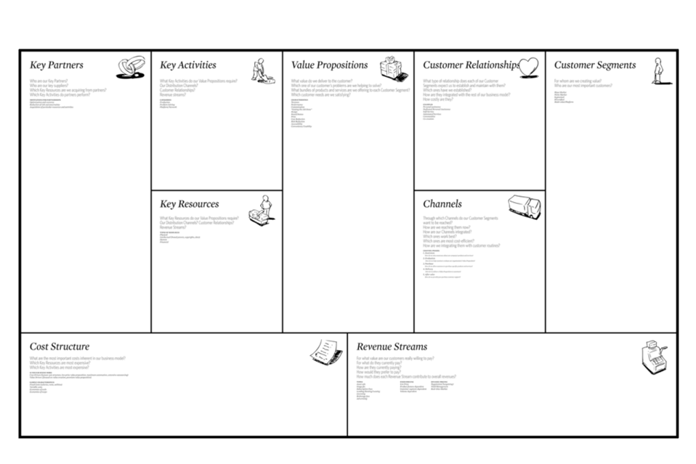
Anatomy of the Business Model Canvas
Note: this is an illustration of the business model canvas.
We will NOT use this canvas in class! It is provided here simply as an illustration of the different elements of a business model.
For explanation see this video:
https://youtu.be/wlKP-BaC0jA
Value Creation Activities
Value Delivery Activities
Product or service (jobs)
Benefits (gains)
Reliefs (pains)
Value Capture Activities

Slide 4
Defining a Job: The Milkshake Example
Click on this link to see a 4-minute video lecture on Customer Jobs: https://youtu.be/VmbSpTJXozk. You need to do this to understand how value propositions work!
Lessons
Think in terms of ’hiring’ products to help you get something done
Customers may hire milkshakes for all kinds of jobs
These jobs may depend on context
Understanding jobs helps us segment the market and recognise our competition
See also: https://guerric.co.uk/jobs-to-be-done-examples/

Slide 5
Value Propositions Address Customer Jobs
”people do not want to buy a quarter-inch drill. They want a quarter-inch hole”
Theodore Levitt (1920 – 2006)

Slide 6
Example: Defining Products in Terms of Jobs
Context exercise
Feature cloud streaming
Job to be done keep motivated during exercise
Gain access to 40 million songs
Pain carrying music around is inconvenient

Slide 7
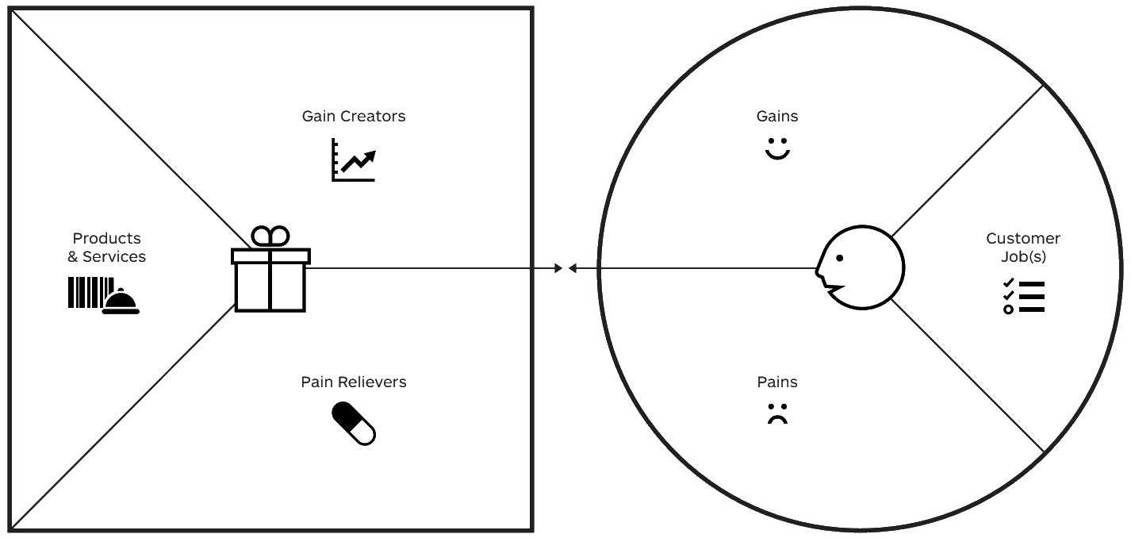
The Value Proposition Canvas
this is my offering!
this is my customer!
Watch this 3-minute video for an explanation: https://youtu.be/ReM1uqmVfP0

Slide 8
Customer Needs and Jobs
What successes?
What expectations?
What delights?
What savings?
What makes life easier?
These are the benefits that you seek with the Job!
What functional jobs?
What emotional jobs?
What social jobs?
What basic needs?
These are the goals you want to accomplish, things you want get done
What barriers?
What costs?
What bad feelings?
What difficulties?
What risks?
These are things that make accomplishing the Job difficult, costly or inconvenient

Slide 9
How Does Our Product Meet Those Needs?
Which products and services help get customer jobs done?
Which products and services do you offer that help your customer get either a functional, social, or emotional job done, or help them satisfy needs and wants? In addition, what ancillary products and services help your customer perform their role as buyer (decision maker), co-creator (customisation or contribution), and transferrer (disposal, reseller, or sharer)?
How do our offerings create gains? Gains are benefits the customer expects, desires or would be surprised by. This includes functional utility, social gains, positive emotions, cost savings...
How do they relieve pains? Pains are negative emotions, undesired costs or situations, and risks the customer (could) experience before, during, or after getting the job done

Slide 10
Ok, these guys sell lemonade in a hot day in the park. But what is their value proposition? Let us analyse their value proposition and express it in one sentence! Check out the slides that follow!

Slide 11
What Benefits Does a Lemonade Stall Offer?
fresh drink
good taste
quenching thirst
when and where you need it
fun
healthy
feel good
natural
sustainable
helping
belonging
All these are elements of value-in-use: They define the amount of discomfort alleviated plus the amount of good feelings generated

Slide 12
What Do Lemonade Stall Customers Need?
What successes?
What expectations?
What delights?
What savings?
What makes life easier?
These are ’extra benefits’ that come above and beyond the core tasks
I like fun exper-iences
I like to live sustainably
I enjoy good taste
I want to lead a healthy lifestyle
I want to help others
I want to be part of community
What functional jobs?
What emotional jobs?
What social jobs?
What basic needs?
These are the goals you want to accomplish, things you want get done
I like to feel good
nice day in the park
I like natural products
feel comfort-able
I like convenient solutions
What barriers?
What costs?
What bad feelings?
What difficulties?
What risks?
These are things that make accomplishing those goals difficult, costly or inconvenient
quench thirst
I get thirsty when walking in the park
participate in community
I get hot when walking in the park
bottled drinks are heavy to carry
eat healthy
canned drinks are resource consuming, unhealthy
I cannot find a drink when I need it
cafeterias are full, noisy and expensive
plastic bottles are a major environmental problem

Slide 13
How Does Our Product Meet Those Needs?
smiling service
kids from neighbor-hood
local produce
How do they create gains?
freshly squeezed
fund-raising mission
fresh lemonade in the park
Which products help get customer jobs done?
fun concept
in the park where you need it
How do they relieve pains?
fresh juice
cool drink
no plastic waste
served from glass

Slide 14
Gain creators should connect with gains and pain relievers with pains!
I like fun exper-iences
I enjoy good taste
I like to live sustainably
smiling service
kids from neighbor-hood
local produce
I want to lead a healthy lifestyle
I want to help others
I want to be part of community
freshly squeezed
fund-raising mission
I like to feel good
fresh lemonade in the park
nice day in the park
fun concept
I like convenient solutions
I like natural products
feel comfort-able
quench thirst
participate in community
I get thirsty when walking in the park
I get hot when walking in the park
in the park where you need it
bottled drinks are heavy to carry
eat healthy
fresh juice
canned drinks are resource consuming, unhealthy
cool drink
cafeterias are full, noisy and expensive
I cannot find a drink when I need it
no plastic waste
served from glass
plastic bottles are a major environmental problem

Slide 15
Let Us Now Use Simple Value Proposition Template to Express Their Value Proposition in One Sentence!
We help [customer or target audience here]
to [job here]
when and where [context here]
We do this by [distinctive gain creators here]
and by [pain relievers here]

Slide 16
Now We Can Succinctly Express Lemon Stall’s Value Proposition!
customer
context
job
gain creators
We help park goers to enjoy their day in the park by helping them quench their thirst with healthy, great tasting, and refreshing lemon juice freshly squeezed from local produce, conveniently offered on site, with smile and friendly service
pain relievers

Slide 17
Ok, now it is your turn! Use the following slides to assess your value proposition (both sides!) and express your value proposition in one sentence. Use and edit the post-it notes to assess customer jobs, pains, gains, your product or service, pain relievers and gain creators. Then use the value proposition template to express your value proposition in one sentence!

Slide 18
Customer Needs and Jobs
What successes?
What expectations?
What delights?
What savings?
What makes life easier?
These are the benefits that you seek with the Job!
What functional jobs?
What emotional jobs?
What social jobs?
What basic needs?
These are the goals you want to accomplish, things you want get done
What barriers?
What costs?
What bad feelings?
What difficulties?
What risks?
These are things that make accomplishing the Job difficult, costly or inconvenient

Slide 19
How Does Our Product Meet Those Needs?
Which products and services help get customer jobs done?
Which products and services do you offer that help your customer get either a functional, social, or emotional job done, or help them satisfy needs and wants? In addition, what ancillary products and services help your customer perform their role as buyer (decision maker), co-creator (customisation or contribution), and transferrer (disposal, reseller, or sharer)?
How do our offerings create gains? Gains are benefits the customer expects, desires or would be surprised by. This includes functional utility, social gains, positive emotions, cost savings...
How do they relieve pains? Pains are negative emotions, undesired costs or situations, and risks the customer (could) experience before, during, or after getting the job done

Slide 20
Let Us Next Map Your Business Model Interactions with the Value Network Mapping Toolkit! Watch this video for an explanation: https://www.youtube.com/watch?v=pq2k0PPz_4k (8 mins)
You can define additional labels (roles) to these icons – e.g., ‘marketplace’; ‘partner’, and so on
6 players
my company
company (define role)
consumer
supplier
non-profit
government
11 objects
to exchange
product
service
experience
exposure
reputation
attention
money
less money
data
right
credits
recurring, direct relationship
conditional relationship (something else needs to happen first)

Slide 21
Players and Stakeholders
Your business
Offers product or service
You!
Partners, other stakeholders
E.g., suppliers, content providers
Client
Individuals (B2C) or companies (B2B)
Receives product or service and gives something in return
my company
supplier
non-profit
government
define role!
consumer
company
see www.boardofinnovation.com

Slide 22
Activity Flow from Company to Client
Product
Straightforward offer
e.g., BMW car
Service
Often in combination with product (eg maintenance of BMW car)
Shift from product to service (eg laundry service of Eletrolux)
Experience
BMW = driving experience
Reputation
Extremely valuable
product
service
experience
reputation
www.boardofinnovation.com

Slide 23
Flows Between Stakeholders
Money
Normal value of good
Incl profit
Less money, credits, tokens
Additional revenue streams
Rights, data
e.g., clients giving up data
e.g., clients giving up image rights
Exposure
spreading ideas
brand value
money
less money
credits
data
right
exposure
www.boardofinnovation.com

Slide 24
Network Mapping: Steps
List the participants in the interaction system (remember to include also supporting participants)
Map interactions between participants: Who interacts with whom?
Map the content of those interactions: What is being exchanged and why?

Slide 25
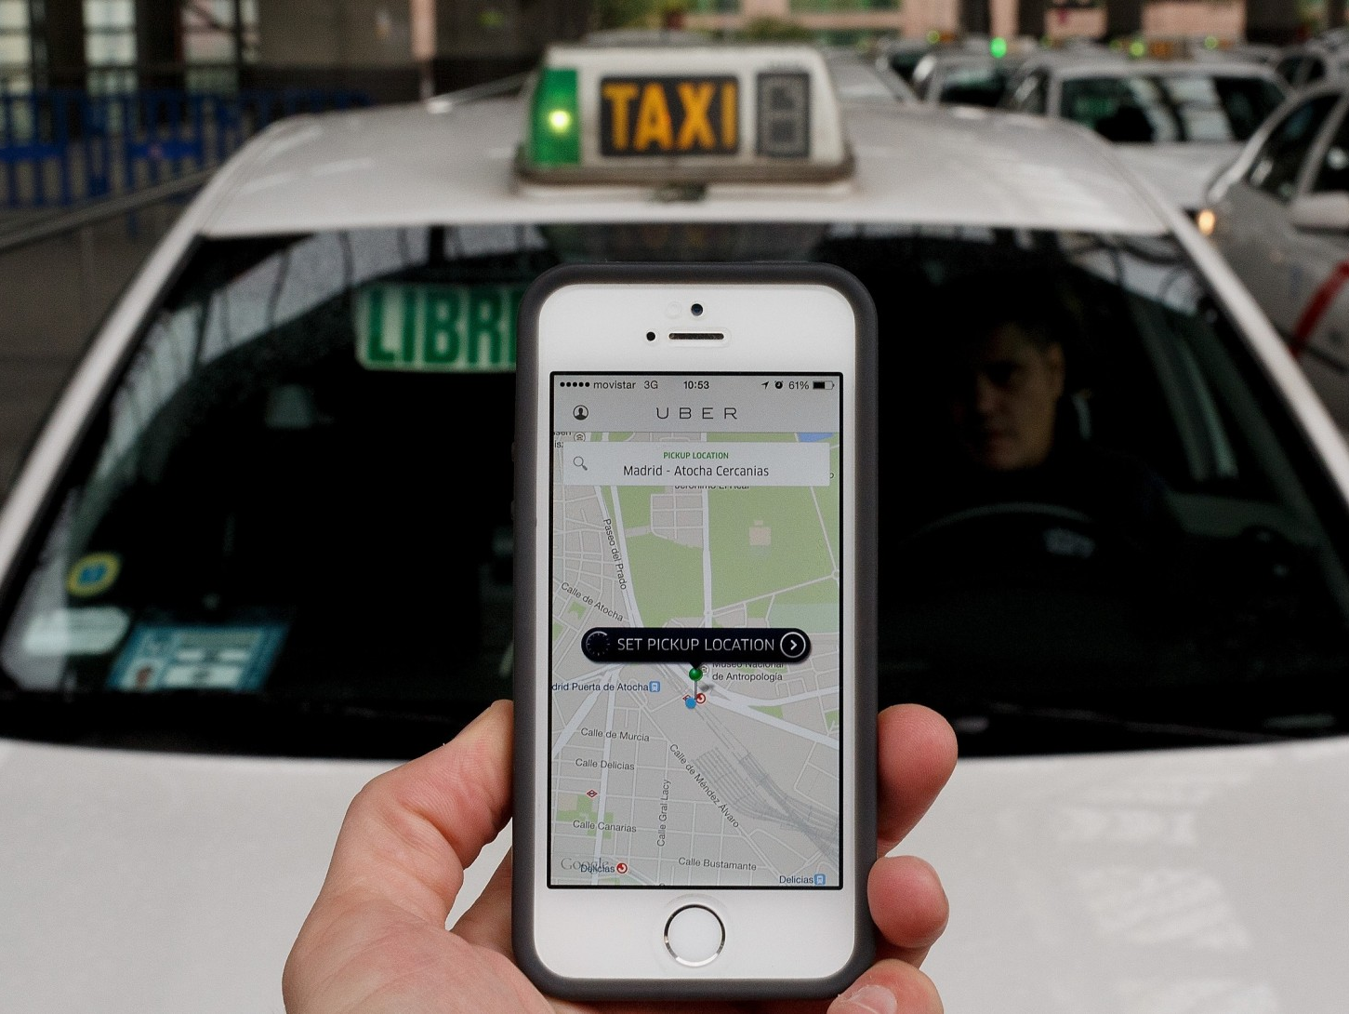
Let us look at an example. What interactions does Uber’s business model have? Who are the stakeholders? What benefits are co-created and exchanged in each interaction? Focus on Uber’s basic business model – the ride hailing service!
Notes:
because of digitalisation, we get disruptive business models that transform the role of asset control and ip ownership (type of ip to be owned and leveraged) in value creation

Slide 26
Network Mapping: Steps
List the participants in the interaction system (remember to include also supporting participants)
List participant roles within the system
Map interactions between participants: Who interacts with whom?
Consider the network map as a whole: What is its overall pattern? Is there a design theme?
What are the most important and central interactions in the system? How do interactions influence one another? Are some interactions mutually reinforcing?
If the system were to be built from scratch, which interactions should be in place first? Are there ‘chicken-and-egg’ problems?

Slide 27
Let Us First Identify the Stakeholders and their Interactions!
government
drivers
third parties (e.g., cities)
user
Notes:
Do as a class exercise:
first ask stakeholders
then map interactions
Then ask about which interactions are most important
Then chicken-and-egg problem: which needs to be in place first?

Slide 28
Let us then Conduct Exchange Analysis
What is the content of exchanges in each interaction?
What is being exchanged?
How do different exchanges relate to one another?

Slide 29
Exchange Analysis: Uber
government
regulatory approval, sanctions
government relations
peak pricing
hot maps
payment of earnings
payment processing
customer assignment
legal services
training
marketing
data services
drivers
third parties (e.g., cities)
data
commission
fees
uber application
transport service
driver rating
clean car
marketing, awareness
order placement
payment
data
user
eta estimates
car tracking
receipt issuance
payment processing
car dispatching
order handling

Slide 30
Value Creation Analysis
What benefits do each participant draw from their interactions?
What are the basic interactions required to set up the system? These are indicated with blue colour in the following slide. These need to be in place first before we can start!
What are the basic interactions to deliver the service? These are marked with red colour.
What are the ‘gain creators’? These add extra value beyond traditional offerings and make our customers fall in love with us!
Finally, are we creating anything extra? Uber generates loads of data that it monetises elsewhere. Data interactions are shown in yellow.

Slide 31
Value Creation Analysis: Uber
government
regulatory approval, sanctions
government relations
peak pricing
hot maps
payment of earnings
payment processing
customer assignment
legal services
training
marketing
data services
drivers
third parties (e.g., cities)
data
commission
fees
uber application
transport service
driver rating
clean car
marketing, awareness
order placement
payment
data
user
eta estimates
car tracking
receipt issuance
payment processing
car dispatching
order handling
Notes:
Do as a class exercise:
first ask stakeholders
then map interactions
Then ask about which interactions are most important
Then chicken-and-egg problem: which needs to be in place first?

Slide 32
Ok, over to you! Use the kit in the following slides to map your own business model interactions in the final empty slide. Follow the steps by the Uber example. While doing this, think: can something be done differently? How do the interactions reinforce one another? What are the most important interactions? Could we change the configuration somehow? Could I create more value or do it more efficiently by re-thinking my business model configuration?

Slide 33
Use these elements to create your own network value map! All the elements are editable, and you can use them to map your business model interactions. If you need help, you can watch this video again: https://www.youtube.com/watch?v=pq2k0PPz_4k
You can define additional labels (roles) to these icons – e.g., ‘marketplace’; ‘partner’, and so on
6 players
my company
company (define role)
consumer
supplier
non-profit
government
11 objects
to exchange
product
service
experience
exposure
reputation
attention
money
less money
data
right
credits
recurring, direct relationship
conditional relationship (something else needs to happen first)

Slide 34
Cut and past the kit elements here to map your own business model!

