Slide 1
Value Proposition and Business Model Design Friday, 11 June 2021
erkko.autio@imperial.ac.uk

Slide 2
Notes:
_{Welcome to the module!}
During these two days, we will focus on the art and science of sustainable business model design.
We will work intensely in teams and go through most of the important steps when crafting, from scratch, a business model that is robust, sustainable, and scalable.
We will be introduced to relevant materials, frameworks, and tools, and learn how to apply them in practice.
We will have clear deliverables for each morning and afternoon session, as well as for the module overall.
I hope you will enjoy this module and our learning journey together!

Slide 3
Notes:
Let me begin by telling a little bit about myself. As you know, I am a full professor at Imperial College Business School, specialising broadly in technology venturing, or more generally, technology-driven and technology-enabled creation, delivery, and realisation (or capture) of value. At ICBS I teach entrepreneurship, business model design, international business, business models and IP, and some doctoral courses. Almost always the focus on my research is on entrepreneurial business, be it a start-up, scale-up, internationalising new business, or a corporate venture. Digitalisation and business model design are at the heart of everything I do. To illustrate, here are a few businesses started by my students. I am sure you can recognise many: the SuperCell designed the clash of clans, MySQL was acquired by Oracle for $1Bn, and CRF Health operates a platform providing pharmaceutical testing services for pharmacies – for example, AstraZeneca, Pfizer, and Biontech could have been their customers. These companies have been extremely successful, with SuperCell leading the pack with an over $10Bn valuation. (I am not claiming that their success had anything to do with me, just basking in their reflected glory).
Rather than to brag, I am showing these because all had innovative business models. MySQL was one of the early software companies to make money and obtain a billion-dollar valuation by giving out their software for free. For a long time they tried the traditional software business model: create the source code, compile it into assembler, print the assembler on to a DVD disc, sell the disc. They made no headway whatsoever. Then they radically changed their business model by making their source code available for free under specific licensing conditions. Sooner than they knew it they were the industry standards for operating database applications in PC environments. Which is why Oracle had to acquire them. Point is, this was not product innovation. Their product remained the same, all that changed was their revenue model, their customer relationship, and how they made their product available to the customer. This was an example where simple tweaks in the business model made a $1Bn difference in their valuation.
CRF business model: pick super cash rich customers (pharma), focus on their most cash-intensive process (drug development and testing), speed up the process with a technology that is peripheral to the user (mobile app), overcome the industry entry barrier by building momentum with a focus on second-tier customers (generic drugs).
Supercell: leverage Apple AppStore and their gaming platform to build $1Bn revenue composing of millions of micro transactions (from a few pence to less than a dollar) all around the world and do it in an economically viable fashion. Accumulation of super-profitable cash flow with millions of global micro transactions.
All these businesses demonstrate that to make money you need to go beyond the product or service. You have to think the entire business model and the value it generates to a defined customer audience in their context. And you have to operationalise the business model in operations that are able to create and deliver the value to the customer in an economically viable fashion. Only then can you make money.

Slide 4
Objectives of this Module
In this module we will look at two tools: Value Proposition Canvas and Business Model Kit. Both tools are designed to help entrepreneurs to critically assess and re-think their business models and value propositions.
Before the module the participants are required to apply both tools to analyse the value propositions and business models of their own businesses. They should bring their results to the class for discussion with and constructive feedback from others. During the class session we will share insights how to use the tools the most effectively.
This slide stack gives you the necessary information and video links so you can self-analyse and map your own value proposition and business model for discussion in class. Please go over this slide stack, watch the recommended videos, and after this, apply the value proposition canvas and the business model kit to analyse your own business! In the class of Friday 11 June we will discuss your analysis and share insights and lessons.
Note! This stack is best viewed in presentation mode! (Press F5 to present)

Slide 5
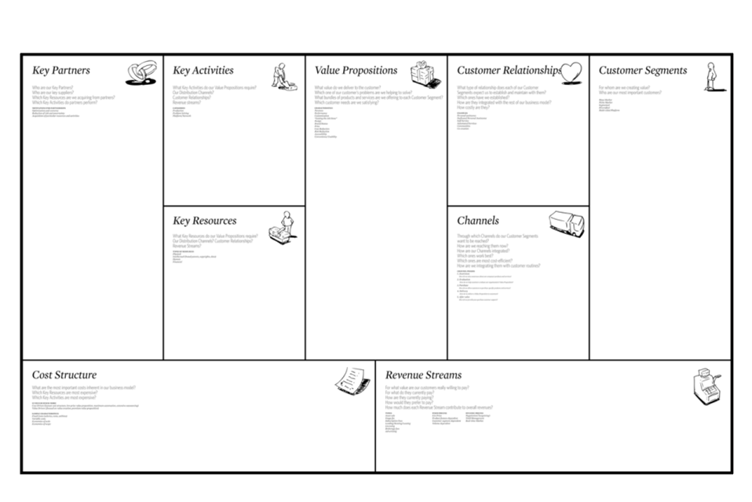
Anatomy of the Business Model Canvas
Note: this is an illustration of the business model canvas.
We will NOT use this canvas in class! It is provided here simply as an illustration of the different elements of a business model.
For explanation see this video:
https://youtu.be/wlKP-BaC0jA
Value Creation Activities
Value Delivery Activities
Product or service (jobs)
Benefits (gains)
Reliefs (pains)
Value Capture Activities

Slide 6
Value-Driven Approach to Business Model Design
bm implementation and scaling
bm validation and de-risking
This Module
value co-creation operationalisation
Business Model Design
Experiment Card
Experimentation Plan
value co-creation design
Concept Vision Card
Awesome Concept Selector
Triple Bottom Line Canvas
value proposition design
Business Model Kit
Network Value Map
Revenue Model Template
Triple E Framework
solution design
problem identification and validation
Design Thinking
Value Proposition Canvas
Value Proposition Statement Template

Slide 7
Defining a Job: The Milkshake Example
Click on this link to see a 4-minute video lecture on Customer Jobs: https://youtu.be/VmbSpTJXozk. You need to do this to understand how value propositions work!
Lessons
Think in terms of ’hiring’ products to help you get something done
Customers may hire milkshakes for all kinds of jobs
These jobs may depend on context
Understanding jobs helps us segment the market and recognise our competition
See also: https://guerric.co.uk/jobs-to-be-done-examples/

Slide 8
Value Propositions Address Customer Jobs
”people do not want to buy a quarter-inch drill. They want a quarter-inch hole”
Theodore Levitt (1920 – 2006)

Slide 9
Example: Defining Products in Terms of Jobs
Context exercise
Feature cloud streaming
Job to be done keep motivated during exercise
Gain access to 40 million songs
Pain carrying music around is inconvenient

Slide 10
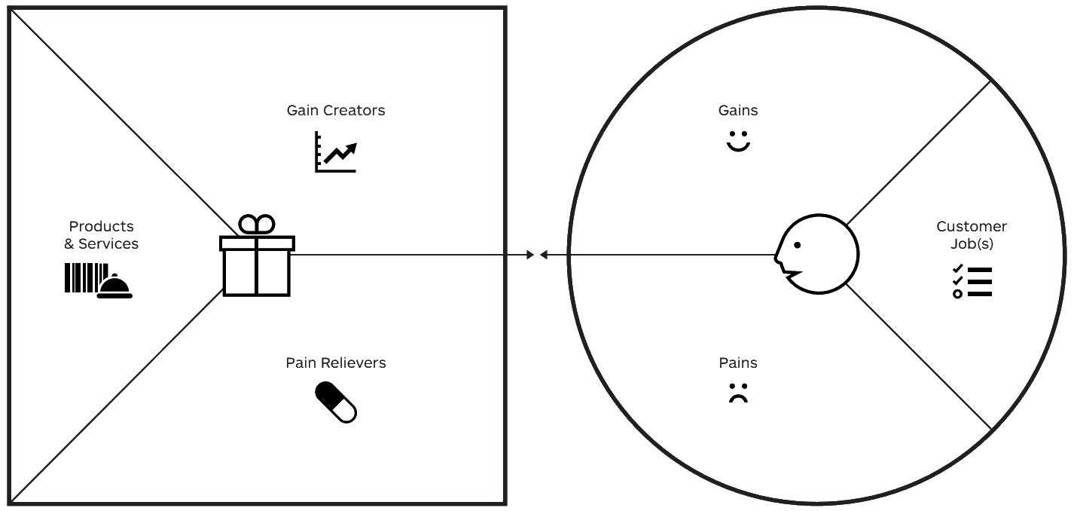
The Value Proposition Canvas
this is my offering!
this is my customer!
Watch this 3-minute video for an explanation: https://youtu.be/ReM1uqmVfP0

Slide 11
Customer Needs and Jobs
What successes?
What expectations?
What delights?
What savings?
What makes life easier?
These are the benefits that you seek with the Job!
I want to experience positive interactions with others
I want to contribute to my community
feeling good
I want to help others
What functional jobs?
What emotional jobs?
What social jobs?
What basic needs?
These are the goals you want to accomplish, things you want get done
What barriers?
What costs?
What bad feelings?
What difficulties?
What risks?
These are things that make accomplishing the Job difficult, costly or inconvenient
eating sustainably
limited variety
eating healthy
difficult to find sustainable health food
healthy food tastes bad (salt tastest good)
cannot trust labels

Slide 12
How Does Our Product Meet Those Needs?
Which products and services help get customer jobs done?
Which products and services do you offer that help your customer get either a functional, social, or emotional job done, or help them satisfy needs and wants? In addition, what ancillary products and services help your customer perform their role as buyer (decision maker), co-creator (customisation or contribution), and transferrer (disposal, reseller, or sharer)?
How do our offerings create gains? Gains are benefits the customer expects, desires or would be surprised by. This includes functional utility, social gains, positive emotions, cost savings...
healthy food
sustainable food
good variety
How do they relieve pains? Pains are negative emotions, undesired costs or situations, and risks the customer (could) experience before, during, or after getting the job done
easy to access and find
good taste
trustworthy certification

Slide 13
Ok, these guys sell lemonade in a hot day in the park. But what is their value proposition? Let us analyse their value proposition and express it in one sentence! Check out the slides that follow!

Slide 14
What Benefits Does a Lemonade Stall Offer?
fresh drink
good taste
quenching thirst
when and where you need it
fun
healthy
feel good
natural
sustainable
helping
belonging
All these are elements of value-in-use: They define the amount of discomfort alleviated plus the amount of good feelings generated

Slide 15
What Do Lemonade Stall Customers Need?
What successes?
What expectations?
What delights?
What savings?
What makes life easier?
These are ’extra benefits’ that come above and beyond the core tasks
I like fun exper-iences
I like to live sustainably
I enjoy good taste
I want to lead a healthy lifestyle
I want to help others
I want to be part of community
What functional jobs?
What emotional jobs?
What social jobs?
What basic needs?
These are the goals you want to accomplish, things you want get done
I like to feel good
nice day in the park
I like natural products
feel comfort-able
I like convenient solutions
What barriers?
What costs?
What bad feelings?
What difficulties?
What risks?
These are things that make accomplishing those goals difficult, costly or inconvenient
quench thirst
I get thirsty when walking in the park
participate in community
I get hot when walking in the park
bottled drinks are heavy to carry
eat healthy
canned drinks are resource consuming, unhealthy
I cannot find a drink when I need it
cafeterias are full, noisy and expensive
plastic bottles are a major environmental problem

Slide 16
How Does Our Product Meet Those Needs?
smiling service
kids from neighbor-hood
local produce
How do they create gains?
freshly squeezed
fund-raising mission
fresh lemonade in the park
Which products help get customer jobs done?
fun concept
in the park where you need it
How do they relieve pains?
fresh juice
cool drink
no plastic waste
served from glass

Slide 17
Gain creators should connect with gains and pain relievers with pains!
I like fun exper-iences
I enjoy good taste
I like to live sustainably
smiling service
kids from neighbor-hood
local produce
I want to lead a healthy lifestyle
I want to help others
I want to be part of community
freshly squeezed
fund-raising mission
I like to feel good
fresh lemonade in the park
nice day in the park
fun concept
I like convenient solutions
I like natural products
feel comfort-able
quench thirst
participate in community
I get thirsty when walking in the park
I get hot when walking in the park
in the park where you need it
bottled drinks are heavy to carry
eat healthy
fresh juice
canned drinks are resource consuming, unhealthy
cool drink
cafeterias are full, noisy and expensive
I cannot find a drink when I need it
no plastic waste
served from glass
plastic bottles are a major environmental problem

Slide 18
Let Us Now Use Simple Value Proposition Template to Express Their Value Proposition in One Sentence!
We help [customer or target audience here]
to [job here]
when and where [context here]
We do this by [distinctive gain creators here]
and by [pain relievers here]

Slide 19
Now We Can Succinctly Express Lemon Stall’s Value Proposition!
customer
context
job
gain creators
We help park goers to enjoy their day in the park by helping them quench their thirst with healthy, great tasting, and refreshing lemon juice freshly squeezed from local produce, conveniently offered on site, with smile and friendly service
pain relievers

Slide 20
Ok, now it is your turn! Use the following slides to assess your value proposition (both sides!) and express your value proposition in one sentence. Use and edit the post-it notes to assess customer jobs, pains, gains, your product or service, pain relievers and gain creators. Then use the value proposition template to express your value proposition in one sentence!

Slide 21
Customer Needs and Jobs
What successes?
What expectations?
What delights?
What savings?
What makes life easier?
These are the benefits that you seek with the Job!
What functional jobs?
What emotional jobs?
What social jobs?
What basic needs?
These are the goals you want to accomplish, things you want get done
What barriers?
What costs?
What bad feelings?
What difficulties?
What risks?
These are things that make accomplishing the Job difficult, costly or inconvenient

Slide 22
How Does Our Product Meet Those Needs?
Which products and services help get customer jobs done?
Which products and services do you offer that help your customer get either a functional, social, or emotional job done, or help them satisfy needs and wants? In addition, what ancillary products and services help your customer perform their role as buyer (decision maker), co-creator (customisation or contribution), and transferrer (disposal, reseller, or sharer)?
How do our offerings create gains? Gains are benefits the customer expects, desires or would be surprised by. This includes functional utility, social gains, positive emotions, cost savings...
How do they relieve pains? Pains are negative emotions, undesired costs or situations, and risks the customer (could) experience before, during, or after getting the job done

Slide 23
Let Us Next Map Your Business Model Interactions with the Value Network Mapping Toolkit! Watch this video for an explanation: https://www.youtube.com/watch?v=pq2k0PPz_4k (8 mins)
You can define additional labels (roles) to these icons – e.g., ‘marketplace’; ‘partner’, and so on
6 players
my company
company (define role)
consumer
supplier
non-profit
government
11 objects
to exchange
product
service
experience
exposure
reputation
attention
money
less money
data
right
credits
recurring, direct relationship
conditional relationship (something else needs to happen first)

Slide 24
Players and Stakeholders
Your business
Offers product or service
You!
Partners, other stakeholders
E.g., suppliers, content providers
Client
Individuals (B2C) or companies (B2B)
Receives product or service and gives something in return
my company
supplier
non-profit
government
define role!
consumer
company
see www.boardofinnovation.com

Slide 25
Activity Flow from Company to Client
Product
Straightforward offer
e.g., BMW car
Service
Often in combination with product (eg maintenance of BMW car)
Shift from product to service (eg laundry service of Eletrolux)
Experience
BMW = driving experience
Reputation
Extremely valuable
product
service
experience
reputation
www.boardofinnovation.com

Slide 26
Flows Between Stakeholders
Money
Normal value of good
Incl profit
Less money, credits, tokens
Additional revenue streams
Rights, data
e.g., clients giving up data
e.g., clients giving up image rights
Exposure
spreading ideas
brand value
money
less money
credits
data
right
exposure
www.boardofinnovation.com

Slide 27
Network Mapping: Steps
List the participants in the interaction system (remember to include also supporting participants)
Map interactions between participants: Who interacts with whom?
Map the content of those interactions: What is being exchanged and why?

Slide 28
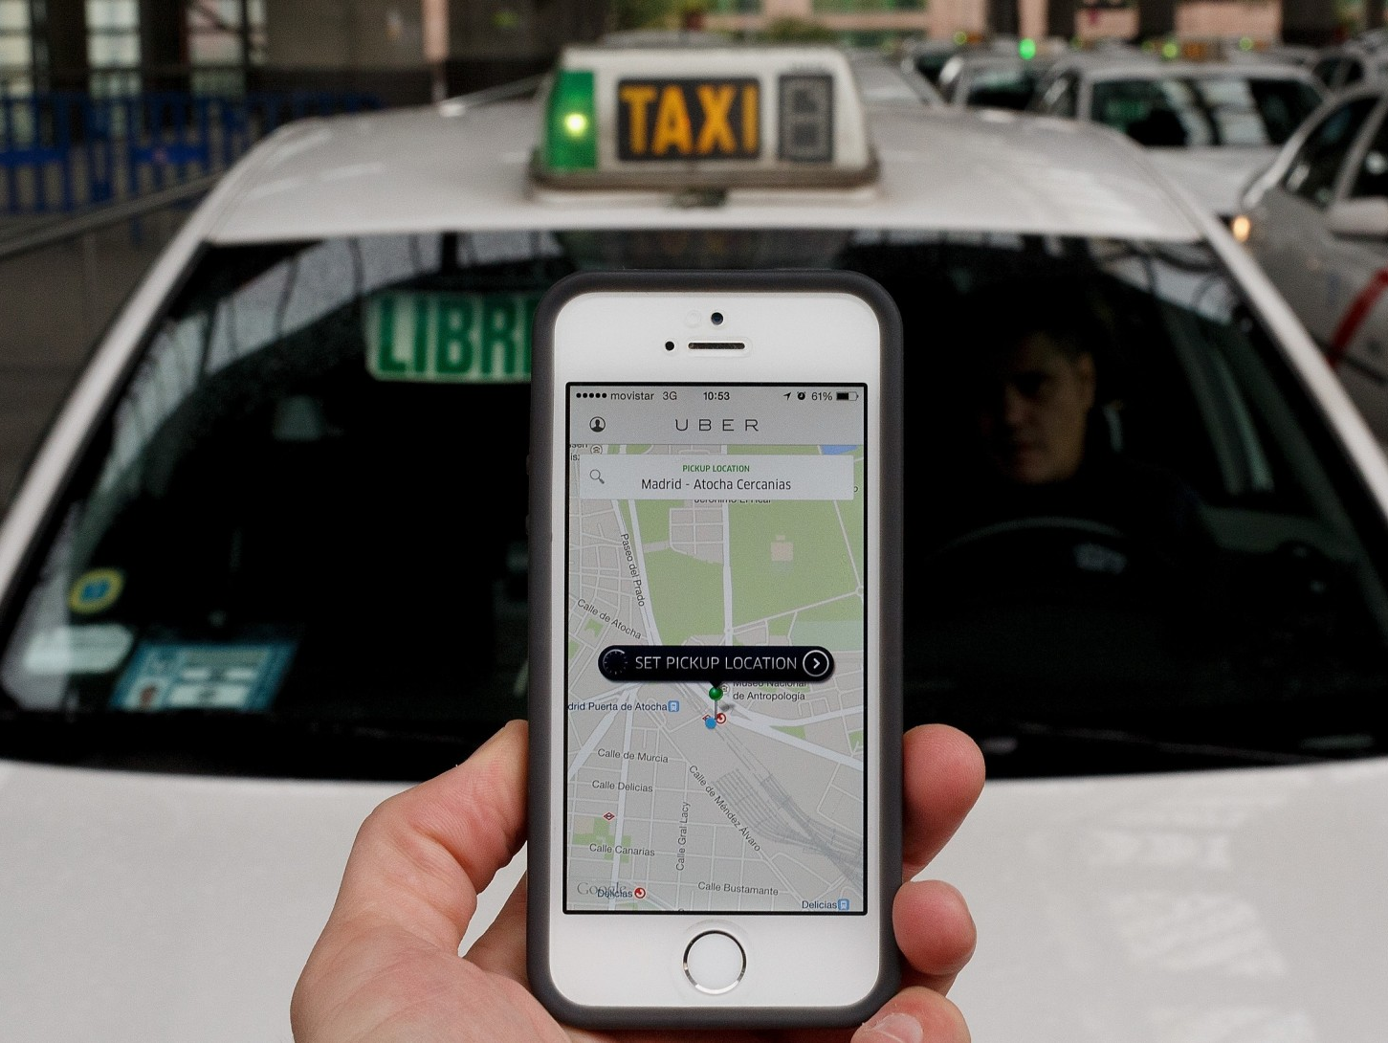
Let us look at an example. What interactions does Uber’s business model have? Who are the stakeholders? What benefits are co-created and exchanged in each interaction? Focus on Uber’s basic business model – the ride hailing service!
Notes:
because of digitalisation, we get disruptive business models that transform the role of asset control and ip ownership (type of ip to be owned and leveraged) in value creation

Slide 29
Network Mapping: Steps
List the participants in the interaction system (remember to include also supporting participants)
List participant roles within the system
Map interactions between participants: Who interacts with whom?
Consider the network map as a whole: What is its overall pattern? Is there a design theme?
What are the most important and central interactions in the system? How do interactions influence one another? Are some interactions mutually reinforcing?
If the system were to be built from scratch, which interactions should be in place first? Are there ‘chicken-and-egg’ problems?

Slide 30
Let Us First Identify the Stakeholders and their Interactions!
government
drivers
third parties (e.g., cities)
user
Notes:
Do as a class exercise:
first ask stakeholders
then map interactions
Then ask about which interactions are most important
Then chicken-and-egg problem: which needs to be in place first?

Slide 31
Let us then Conduct Exchange Analysis
What is the content of exchanges in each interaction?
What is being exchanged?
How do different exchanges relate to one another?

Slide 32
Exchange Analysis: Uber
government
regulatory approval, sanctions
government relations
peak pricing
hot maps
payment of earnings
payment processing
customer assignment
legal services
training
marketing
data services
drivers
third parties (e.g., cities)
data
commission
fees
uber application
transport service
driver rating
clean car
marketing, awareness
order placement
payment
data
user
eta estimates
car tracking
receipt issuance
payment processing
car dispatching
order handling

Slide 33
Value Creation Analysis
What benefits do each participant draw from their interactions?
What are the basic interactions required to set up the system? These are indicated with blue colour in the following slide. These need to be in place first before we can start!
What are the basic interactions to deliver the service? These are marked with red colour.
What are the ‘gain creators’? These add extra value beyond traditional offerings and make our customers fall in love with us! These are marked with green colour.
Finally, are we creating anything extra? Uber generates loads of data that it monetises elsewhere. Data interactions are shown in yellow.

Slide 34
Value Creation Analysis: Uber
government
regulatory approval, sanctions
government relations
peak pricing
hot maps
payment of earnings
payment processing
customer assignment
legal services
training
marketing
data services
drivers
third parties (e.g., cities)
data
commission
fees
uber application
transport service
driver rating
clean car
marketing, awareness
order placement
payment
data
user
eta estimates
car tracking
receipt issuance
payment processing
car dispatching
order handling
Notes:
Do as a class exercise:
first ask stakeholders
then map interactions
Then ask about which interactions are most important
Then chicken-and-egg problem: which needs to be in place first?

Slide 35
Ok, over to you! Use the kit in the following slides to map your own business model interactions in the final empty slide. Follow the steps by the Uber example. While doing this, think: can something be done differently? How do the interactions reinforce one another? What are the most important interactions? Could we change the configuration somehow? Could I create more value or do it more efficiently by re-thinking my business model configuration?

Slide 36
Use these elements to create your own network value map! All the elements are editable, and you can use them to map your business model interactions. If you need help, you can watch this video again: https://www.youtube.com/watch?v=pq2k0PPz_4k
You can define additional labels (roles) to these icons – e.g., ‘marketplace’; ‘partner’, and so on
6 players
my company
company (define role)
consumer
supplier
non-profit
government
11 objects
to exchange
product
service
experience
exposure
reputation
attention
money
less money
data
right
credits
recurring, direct relationship
conditional relationship (something else needs to happen first)

Slide 37
Cut and paste the kit elements here to map your own business model!

Slide 38
What Do Lemonade Stall Customers Need?
What successes?
What expectations?
What delights?
What savings?
What makes life easier?
These are ’extra benefits’ that come above and beyond the core tasks
I like to be efficient
I want to use my time productively
What functional jobs?
What emotional jobs?
What social jobs?
What basic needs?
These are the goals you want to accomplish, things you want get done
I like to project a professional outlook
transport from A to B
What barriers?
What costs?
What bad feelings?
What difficulties?
What risks?
These are things that make accomplishing those goals difficult, costly or inconvenient
safe transport
payment is a hassle and takes time
what if they do not accept credit card?
hassle free transport
drivers cannot be trusted
are they taking the quickest route?
you never find a cab when you need it
you never know when and if they arrive

Slide 39
How Does Our Product Meet Those Needs?
send ETA estimate
share location
How do they create gains?
don’t spend time waiting
Uber application
Which products help get customer jobs done?
automatic electronic receipt
access to large pool of drivers (visible on map)
personal mobility service from A to B
How do they relieve pains?
Uber handles credit card
driver arrival time
automatic payment
transparent route map with Google
driver ratings

Slide 40
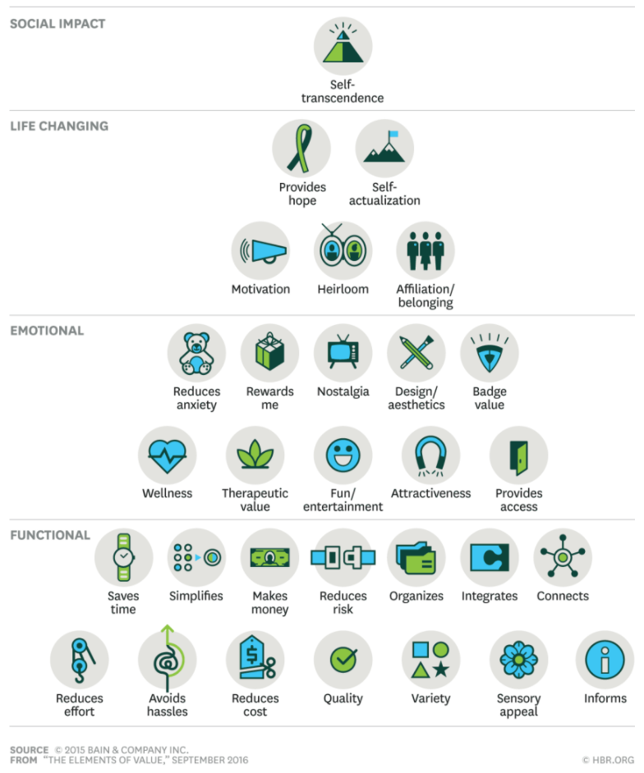
Elements of Consumer Value (Possible Gains)
Source: Almquist, Senior & Bloch. 2016. The Elements of Value. Harvard Business Review, September: 46-53
Notes:
Here the point is to use this as a guide that helps them understand the value proposition canvas and the network value map better. This canvas informs upon pains and gains and helps identify ways to boost value.

Slide 41
Elements of B2B Value
Almquist, Eric, Jamie Cleghorn, and Lori Sherer. "The B2B elements of value." Harvard Business Review 96.3 (2018): 18.
(accessible through Imperial library)

Slide 42
Triple Bottom Line Canvas and Integrating Sustainability Mission with Business Mission
erkko.autio @imperial.ac.uk

Slide 43
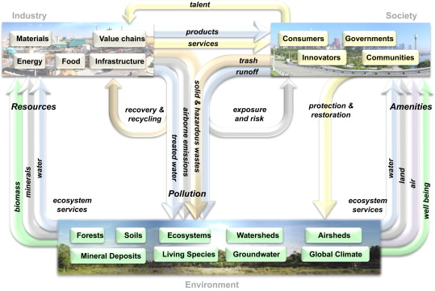
Sustainability: A Systems of Systems Perspective
fiksel, j. 2012. a systems view of sustainability: the triple value model. environmental development, 2: 138-141

Slide 44
Sustainable Business Models: Dimensions
Environmental Impact
Closed loop production: recycle materials used in production
Physical to virtual: replace physical infrastructure with digital service
On-demand production: produce only when demand is confirmed
Rematerialisation: re-use waste
Product as service: pay for the service product provides
Progressive purchase: lease or rent what you cannot buy outright
Social Impact
Buy one, give one: for each sale, donate a similar good
Cooperative: stakeholder ownership and participation
Inclusive sourcing: fair practices over supply chain
Social crowdfunding: raise money in increments from a group of people
Social mission: address community problem as part of business mission
Behavior change: stimulate behavior change through nudging
Base of Pyramid
Alternative marketplace: ensuring fair trading practices
Differential pricing: subsidise those with low income
Microfinance: borrowing for low-income segments
Micro-franchise: franchise concept for base of pyramid
Adapted and modified from www.sustainability.com

Slide 45
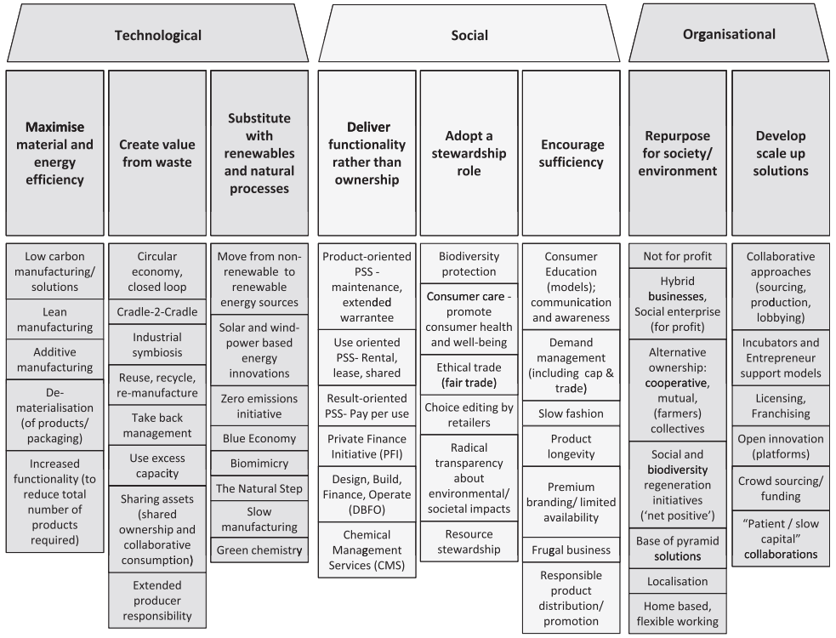
Sustainable Business Model Archetypes
Bocken, n., et al. (2014). “A literature and practice review to develop sustainable business model archetypes." Journal of Cleaner Production 65: 42–56

Slide 46
Triple Bottom Line Canvas
key partners key partners: who do you work with to deliver your value proposition? do not forget to list your partners in your social impact mission – e.g., charities, community groups, and so on ecological impact mission – e.g., eco-certification agencies, closed-loop partners, reforestation initiatives | key activities key activities: what do you do yourself to deliver your customer value proposition? | customer value proposition value proposition: what jobs do you perform for your customers? what pains do you alleviate? what gains do you contribute? also list what makes your value proposition distinctive relative to others! see link for further detail | customer relationships what kind of relationship do you maintain with your different customers? see link for examples | customer groups which customer groups do you service? note that multi-sided business models may have many different customers! also distinguish between ’users’ (e.g., facebook users – who would also be their key resource) and paying customers (e.g., advertisers)
 |  |  | customer channels how do you reach your customers? how do you integrate with their routines? also describe your multi-channel strategy, if any!
societal services which societal services do you rely on? list all societal services important for your business such as infrastructure, institutions (e.g., rule of law, security, R&D environment), human capital, social services (e.g., child care, education), subsidies and grants, tax relief, similar | key resources what resources you draw on to deliver your value proposition? consider physical, human, and financial resources. specifically consider your intellectual assets: ip plus intellectual capital! | social impact mission describe here your social impact mission. how do you demonstrate good citizenship? how do you contribute to your local community? how do you improve people’s lives and the general societal well-being beyond your core business mission? | community relationships what relationships do you maintain with the local communities where you are present? how do you engage these communities? | community stakeholders who are the beneficiaries of your social impact mission? note that your business may have direct beneficiaries (those directly targeted) and secondary ones (those experiencing secondary benefits such as greater prosperity, lower unemployment, reduced crime rate)
 |  |  | social channels what are the specific channels and activities through which you deliver on your social impact mission?
ecosystem services list the natural ecosystem services your operation uses: biomass, minerals, water, air, soil, forests, non-renewable energy. we are interested in your environmental footprint! | mission integration how do you ensure you do not lose sight on your social and environmental missions? list the governance structures and procedures that ensure that these impact propositions are incorporated in your corporate decision making! | ecological impact mission how are you going to deliver a positive impact on your natural environment? e.g., how do you minimise your ecosystem footprint, deliver a specific ecosystem impact beyond your business mission (e.g., reforestation projects), or, for example, eliminate resource-consuming activities from your business model? how do you make your business and the natural environment more ecologically sustainable? | ecosystem channels what are the specific channels and mechanisms through which you deliver your impact on the natural ecosystem? these might be internal (e.g., recycling, repairing, rematerialisation) and external (e.g., participation in specific ecosystem initiatives) | ecosystem beneficiaries who are your ecosystem beneficiaries? these may be living things (inhabitants of the ecosphere) and non-living ones (ecosystem resources such as air, water, minerals)
cost structure what is the cost structure of your business? indicate both direct costs generated by your internal activities as well as costs generated through outsourcing, license agreements, and similar. also elaborate costs associated with your social and ecological impact missions |  | surplus streams does your business generate specific surpluses to support your social and ecological impact missions? these might be financial (e.g., donations by customers, share of profit) or material (e.g., collected materials for recycling). also describe here how your business, social, and ecological missions integrate and reinforce one another! | revenue streams how does your business generate revenue? indicate both primary sources of revenue (from primary interactions within the business model) and secondary sources (e.g., monetisation of data resources and additional ip generated by the primary interactions)
Designed by Erkko Autio (2020). PowerPoint version available from me.
This canvas builds on and extends the business model canvas by Strategyzer AG. Hyperlinks point back to Strategyzer.
This work is licensed under a Creative Commons Attribution-ShareAlike 4.0 International License. Feel free to use and build on with appropriate attribution to my LinkedIn page.
Notes:
Explain: left side (societal, ecosystem services) required to make it explicit how the business uses free resources that go unpaid for under a tax evasion
Social impact mission: arises from the businesse’s presence in communities, including its employees: who do we touch? How? What good do we generate?
Ecological impact mission: how do we reduce our negative impact on the natural environment? Supply chain organisation and circularity? Reduction of waste (raw materials, energy)? How do we compensate for our footprint (restoration activities)? Product design? Dematerialisation?
Social channels: whose lives do we touch? Examples: communities, intermediary organisations, clubs, social services, campaigns
Community relationships: community operation, engagement activities, campaigns, pihlantropic
Mission integration: governance systems, strategic decision making, compensation, personnel policies
Surplus streams and their reallocation (esp to nonrelated activities)

Slide 47
How to Use the Triple Bottom Line Canvas
key partners key partners: who do you work with to deliver your value proposition? do not forget to list your partners in your social impact mission – e.g., charities, community groups, and so on ecological impact mission – e.g., eco-certification agencies, closed-loop partners, reforestation initiatives | key activities key activities: what do you do yourself to deliver your customer value proposition? | customer value proposition value proposition: what jobs do you perform for your customers? what pains do you alleviate? what gains do you contribute? also list what makes your value proposition distinctive relative to others! see link for further detail | customer relationships what kind of relationship do you maintain with your different customers? see link for examples | customer groups which customer groups do you service? note that multi-sided business models may have many different customers! also distinguish between ’users’ (e.g., facebook users – who would also be their key resource) and paying customers (e.g., advertisers)
 |  |  | customer channels how do you reach your customers? how do you integrate with their routines? also describe your multi-channel strategy, if any!
societal services which societal services do you rely on? list all societal services important for your business such as infrastructure, institutions (e.g., rule of law, security, R&D environment), human capital, social services (e.g., child care, education), subsidies and grants, tax relief, similar | key resources what resources you draw on to deliver your value proposition? consider physical, human, and financial resources. specifically consider your intellectual assets: ip plus intellectual capital! | social impact mission describe here your social impact mission. how do you demonstrate good citizenship? how do you contribute to your local community? how do you improve people’s lives and the general societal well-being beyond your core business mission? | community relationships what relationships do you maintain with the local communities where you are present? how do you engage these communities? | community stakeholders who are the beneficiaries of your social impact mission? note that your business may have direct beneficiaries (those directly targeted) and secondary ones (those experiencing secondary benefits such as greater prosperity, lower unemployment, reduced crime rate)
 |  |  | social channels what are the specific channels and activities through which you deliver on your social impact mission?
ecosystem services list the natural ecosystem services your operation uses: biomass, minerals, water, air, soil, forests, non-renewable energy. we are interested in your environmental footprint! | mission integration how do you ensure you do not lose sight on your social and environmental missions? list the governance structures and procedures that ensure that these impact propositions are incorporated in your corporate decision making! | ecological impact mission how are you going to deliver a positive impact on your natural environment? e.g., how do you minimise your ecosystem footprint, deliver a specific ecosystem impact beyond your business mission (e.g., reforestation projects), or, for example, eliminate resource-consuming activities from your business model? how do you make your business and the natural environment more ecologically sustainable? | ecosystem channels what are the specific channels and mechanisms through which you deliver your impact on the natural ecosystem? these might be internal (e.g., recycling, repairing, rematerialisation) and external (e.g., participation in specific ecosystem initiatives) | ecosystem beneficiaries who are your ecosystem beneficiaries? these may be living things (inhabitants of the ecosphere) and non-living ones (ecosystem resources such as air, water, minerals)
cost structure what is the cost structure of your business? indicate both direct costs generated by your internal activities as well as costs generated through outsourcing, license agreements, and similar. also elaborate costs associated with your social and ecological impact missions |  | surplus streams does your business generate specific surpluses to support your social and ecological impact missions? these might be financial (e.g., donations by customers, share of profit) or material (e.g., collected materials for recycling). also describe here how your business, social, and ecological missions integrate and reinforce one another! | revenue streams how does your business generate revenue? indicate both primary sources of revenue (from primary interactions within the business model) and secondary sources (e.g., monetisation of data resources and additional ip generated by the primary interactions)
Designed by Erkko Autio (2020). PowerPoint version available from me.
This canvas builds on and extends the business model canvas by Strategyzer AG. Hyperlinks point back to Strategyzer.
This work is licensed under a Creative Commons Attribution-ShareAlike 4.0 International License. Feel free to use and build on with appropriate attribution to my LinkedIn page.
Notes:
Explain: left side (societal, ecosystem services) required to make it explicit how the business uses free resources that go unpaid for under a tax evasion
Social impact mission: arises from the businesse’s presence in communities, including its employees: who do we touch? How? What good do we generate?
Ecological impact mission: how do we reduce our negative impact on the natural environment? Supply chain organisation and circularity? Reduction of waste (raw materials, energy)? How do we compensate for our footprint (restoration activities)? Product design? Dematerialisation?
Social channels: whose lives do we touch? Examples: communities, intermediary organisations, clubs, social services, campaigns, direct employment, training (Fifteen)
Community relationships: community operation, engagement activities, campaigns, pihlantropic
Mission integration: governance systems, strategic decision making, compensation, personnel policies
Surplus streams and their reallocation (esp to nonrelated activities)

Slide 48
Turning Sustainability to Innovation Driver
Stage 1: Turning compliance into opportunity through proactive adaptation (develop products to a higher standard)
Stage 2: Making value chains sustainable
(circularisation, sustainable sourcing, sustainable materials, supplier practices, tighter standards, proof of origin, labour standards)
Stage 3: Defining sustainable proudcts and services
(modularisation; design for repair, rematerialise, reuse; digitalisation; energy efficiency; raw materials)
Stage 4: Developing new business models
(product-as-a-service; components-as-a-service; materials-as-a-service; rematerialisation; recovery)

Slide 49
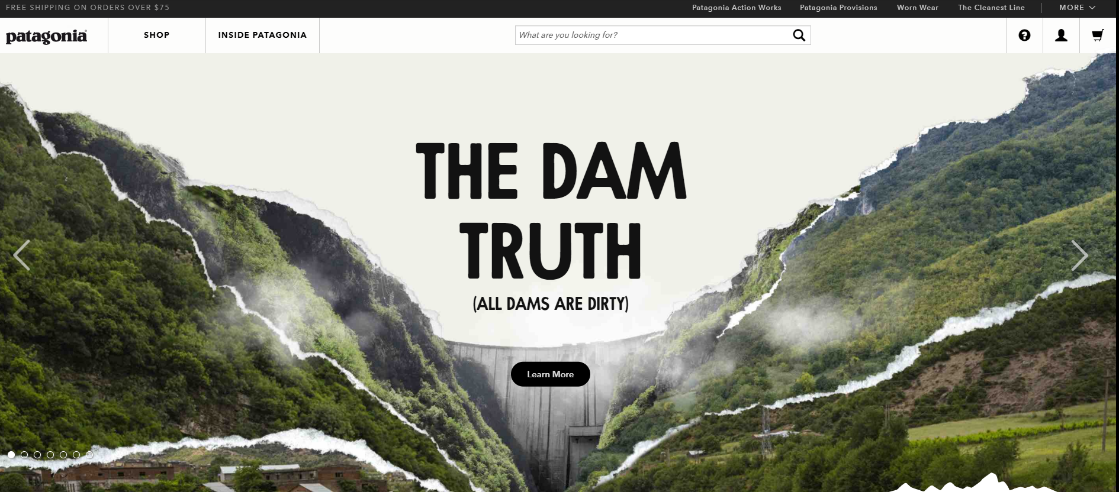
Patagonia

Slide 50
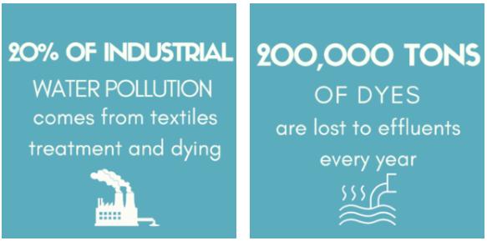
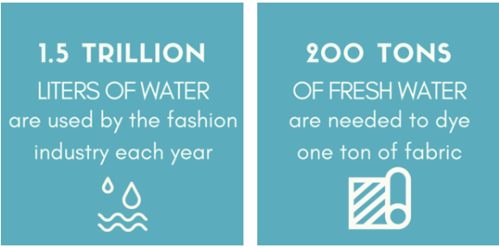
Fashion Facts
https://www.sustainyourstyle.org/old-environmental-impacts
Notes:
fashion is the 2nd most polluting industry after oil
fashion generates an environmental impact greater than air travel and maritime logistics industries combined

Slide 51
Patagonia: Insights
What is the business model of patagonia for its for-profit mission?
product and service offering, operations
customer segments, value proposition
revenue model
What is the impact model of patagonia for its ecological mission?
ecological impact proposition, beneficiaries
ecosystem services used
ecological impact in operations, governance
What is the impact model of patagonia for its social mission?
social impact proposition, stakeholders
social impact channels
social impact in operations, governance
All: how do the three missions reinforce one another?

Slide 52
Patagonia: Guiding Principles
Simplicity and functionality in product design
Infrequent model upgrades
Multifunctional products
Sustainable raw materials
organically grown cotton
less environmentally damaging dye
100% recyclable zippers
r&d for durable fabrics
chlorine-free wool
recycled polyester fleece
Four ‘r’ principle
‘r’educe buys (multifunctionality, durability)
‘r’epair damaged wear (repair service centres)
‘r’euse (unwanted used gear: worn wear)
‘r’ecycle as much as possible
Fair outsourcing
Supplier, dealer commitment to one percent for the planet
Supplier vetting

Slide 53
Triple Bottom Line Canvas for Patagonia
key partners fair trade b lab bluedesign system the conservation alliance fair factories clearinghouse fair labour association oia eco working group sustainable apparel coalition textile exchange | key activities apparel design, manufacture r&d reduce, repair, reuse, recycle, rematerialise supplier, partner advisory social, environmental activism (see social channels) | customer value proposition we supply well-designed garments and apparel for outdoor activities in a socially and environmentally sustainable fashion and adhering to triple bottom line principles. we apply a responsible, life-cycle approach both to our suppliers and products and undertake to repair an recycle products no longer needed or used by our customers | customer relationships customer commitment end-to-end approach to product life management extended relationship beyond transaction to a lifecycle approach | customer groups outdoors enthusiasts environmentally conscious socially conscious well off liberal educated
 |  |  | customer channels outlets online retail re-use programme footprint chronicles
societal services education human capital institutional environment rule of law, contract enforcement infrastructure public spaces, natural environment | key resources minimalist, durable product design material r&d repair centres energy efficient buildings environmental activism knowledge base utility patents design patents brand | social impact mission we advance socially sustainable business by promoting fair trade practices and applying a social stakeholder perspective in our business governance | community relationships active participation in supplier communities social mission training | community stakeholders suppliers employees suppliers employees targeted communities
 |  |  | social channels fair trade usa (supplier worker empowerment, living wage practices, fair trade certified sewing) environmental advocacy training employee activism social impact initiatives
ecosystem services cotton polyesters energy water raw materials land air environment | mission integration company ethos and culture hiring practices alliance memberships sabbaticals to work in environmental organisations surf breaks bail payment fund footprint chronicles | ecological impact mission we advance sustainable business by actively developing and applying sustainable practices in our products, operations, and supplies, as well as by advancing and advocating sustainability principles and sponsoring environmental initiatives | ecosystem channels ecosystem campaigns supply chain activities (closed loop) | ecosystem beneficiaries targeted ecosystems the environment biophysical resource stocks water land
cost structure what is the cost structure of your business? indicate both direct costs generated by your internal activities as well as costs generated through outsourcing, license agreements, and similar. also elaborate costs associated with your social and ecological impact missions |  | surplus streams 1% for the environment social and ecosystem mission driving brand value (’patagucci’), which generates surplus to be used on environmental and social missions | revenue streams how does your business generate revenue? indicate both primary sources of revenue (from primary interactions within the business model) and secondary sources (e.g., monetisation of data resources and additional ip generated by the primary interactions)
Notes:
Press the frame of the canvas to activate the video (2 minutes, explains what business model canvas contains).
Business plan is the simple articulation of a business model.
In essence, the left side is all about resources. The right side is all about customer relationships and revenue streams
The top side is about value creation
The bottom is about value capture
Top left corner: what is our partnering strategy?
Who do we ally with? Who helps us create the product or service? Why would they partner with us?
This block connects with the network. Networking strategies are important
Key activities simply refers to mapping what it entails to create and deliver the product or service (use GEDI example here!)
Key resources is what you need to put this in place…
Value proposition is in the middle: what do you think goes in there? Any guesses? (Note: they need to discover that this is where the market need and product concept goes. Which is what they have just learned).
Customers: how do you interact with them. How do you reach them. What the customer segments are (sound familiar?).
About interaction. Use high- or low-value strategy. Example cars. How do you interact with a BMW owner. How do you interact with a VW buyer. Completely different things
Tell story about selling custom built yachts. Have you ever seen any ads for yachts? Why not? Because the buyers do not want to be seen as one of many!
Revenue streams and cost structure will be about financials, to be discussed later during the course.

Slide 54
Keeping Your Eye on the Ball: Two Considerations
Are my clients also beneficiaries of my social mission?
If so, it will be easier to keep focus on your social mission
Does my business mission directly drive social impact?
If so, it will be easier to keep focus on your social mission
If the answer to either of the questions above is ’no’, then you need to think about how you can ensure continued focus on your social mission!

Slide 55
Social or ’Hybrid’ Business Models
Mission directly drives
social impact
Bridging Hybrid
Intermediate risk of mission drift
Moderately difficult financial sustainability
Example: Dialogue in the Dark, Aravind Eye Hospital,
Auticon in UK, Germany (IT jobs for autistic persons)
Market Hybrid
Low risk of mission drift
Straightforward financial sustainability
Example: oorja
Clients are NOT beneficiaries
Clients ARE beneficiaries
Coupling Hybrid
High risk of mission drift
Challenging financial sustainability
Example: Wise uk (employment plus training for addicts)
Blending Hybrid
Intermediate risk of mission drift
Moderately difficult financial sustainability
Example: bharat microfinance (financial training required for sustainable results)
Indirect pathway
to social impact: Additional
activities required
Santos et al, CMR 2015

Slide 58
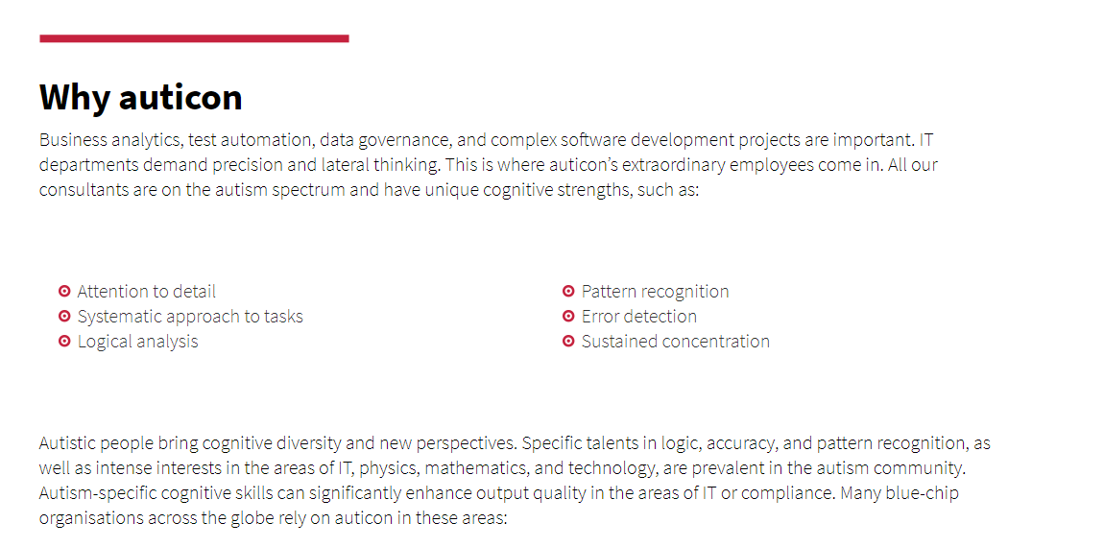

Slide 59
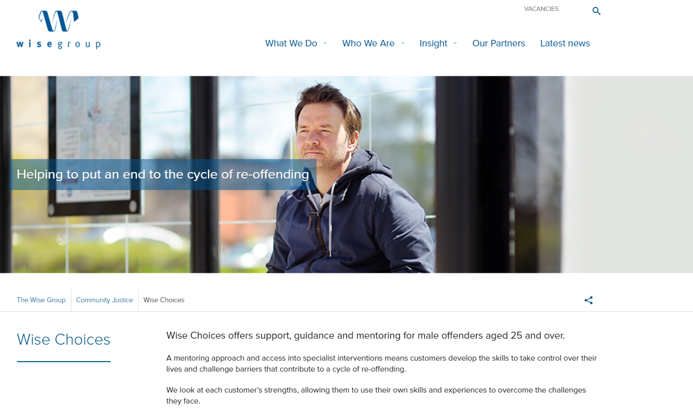

Slide 61
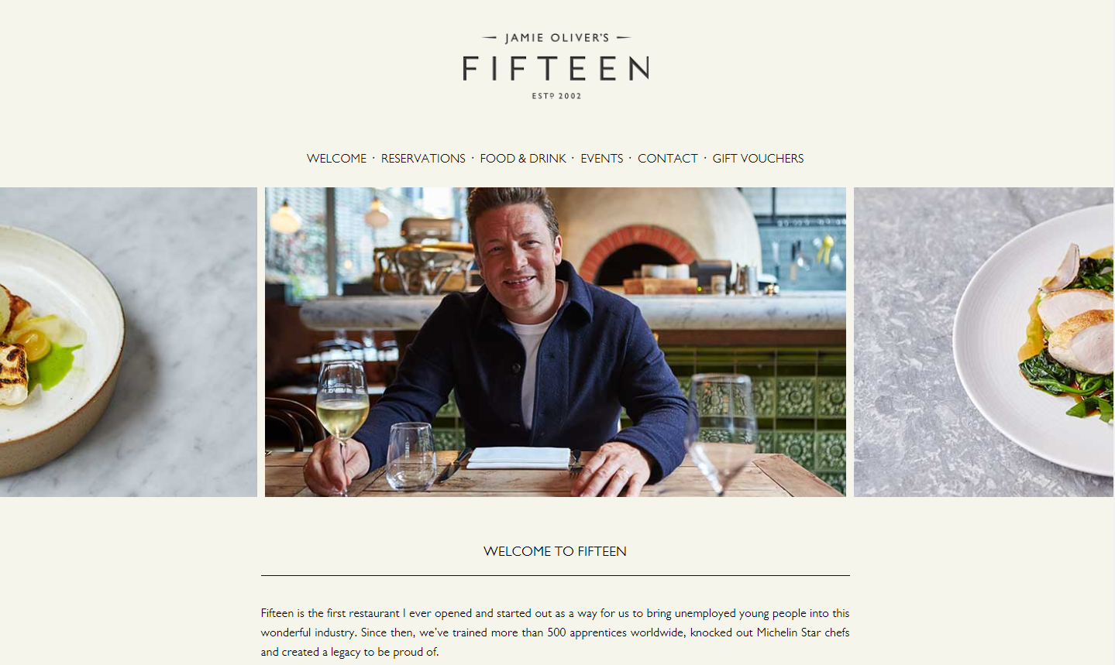
Notes:
Fifteen is the name of the restaurants and the supporting charitable foundation. The foundation's mission is to inspire disadvantaged youth, including those with drug or alcohol problems, the unemployed and the homeless, to believe in themselves and the possibility of becoming chefs.
The foundation aims to turn Fifteen into a global social enterprise brand. The first was in London in 2002. December 2004 saw the opening of a second restaurant in Amsterdam, with others following in Cornwall (May 2006) and Fifteen Melbourne, Australia (September 2006).

Slide 62
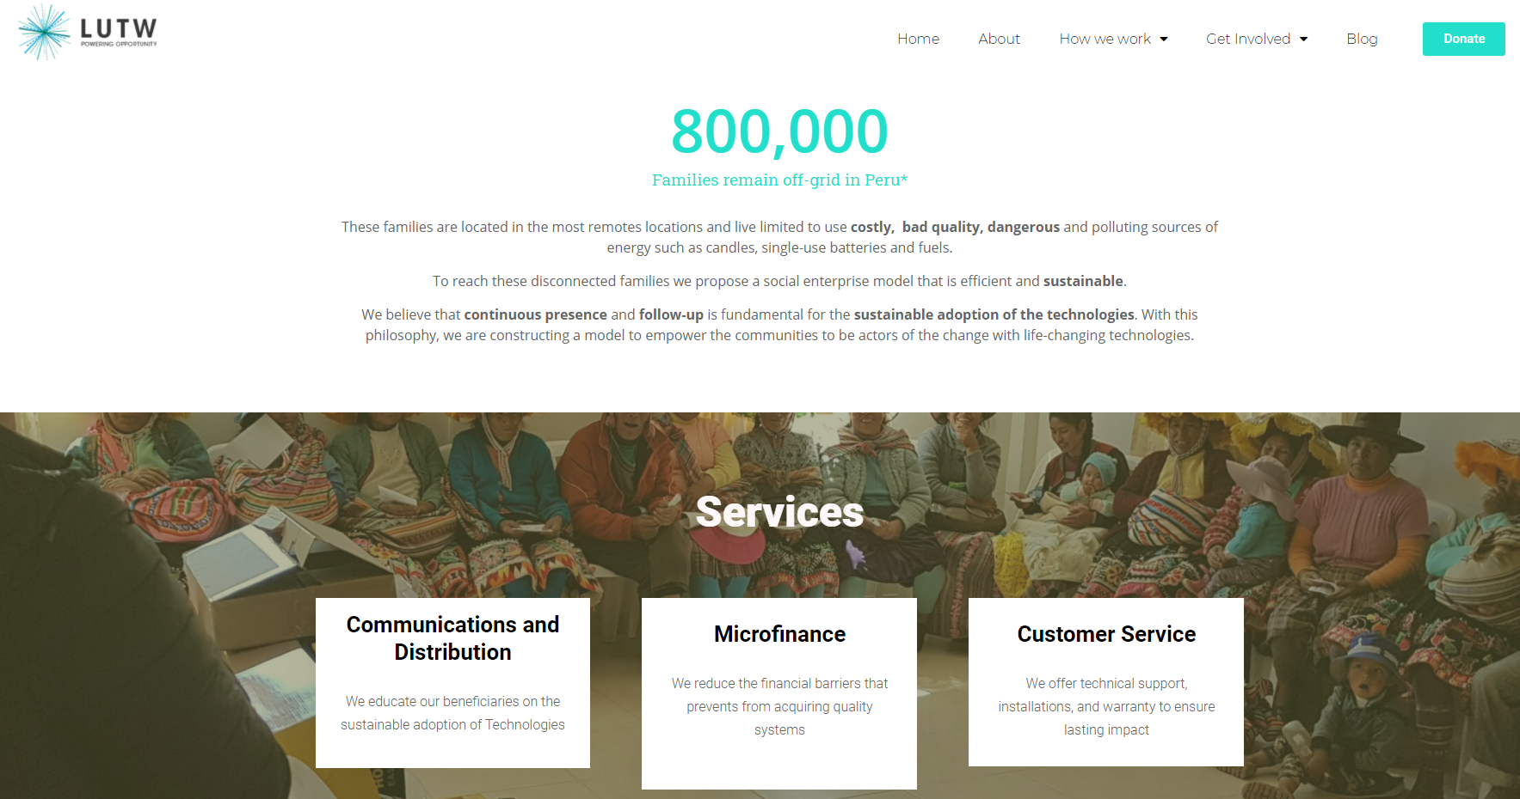

Slide 63
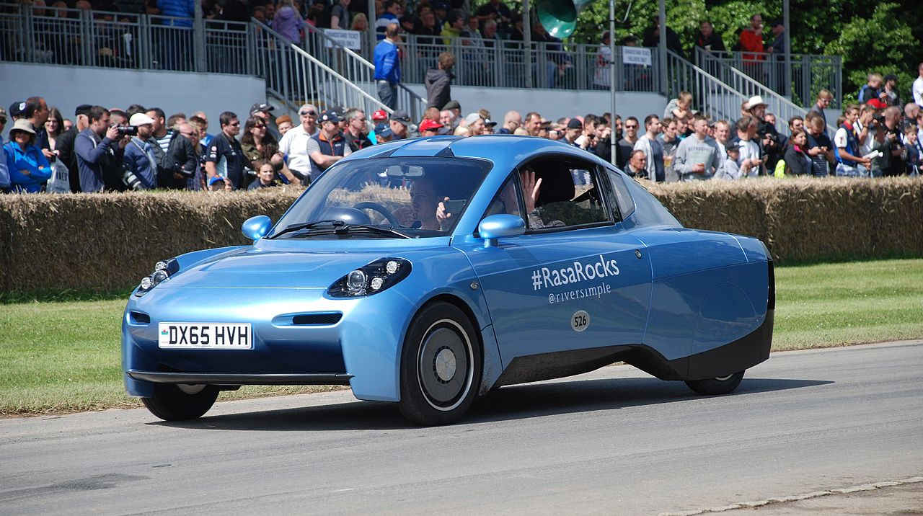
riversimple

Slide 64
Riversimple History and Operation
Founded in 2001 by Hugo Spowers
Designs and (eventually) manufactures hydrogen-powered fuel cell electric vehicles (FCEVs)
Mission: to pursue, systematically, the elimination of the environmental impact of personal transport
”Whole system design”: for-profit governance structure plus six ’custodians’ (stakeholders)
First prototype, Rasa, unveiled 17 Feb 2016
Open source (and open design) philosophy
Sell car-centric mobility service (MaaS): Subscription model that includes car, service, fuel

Slide 65
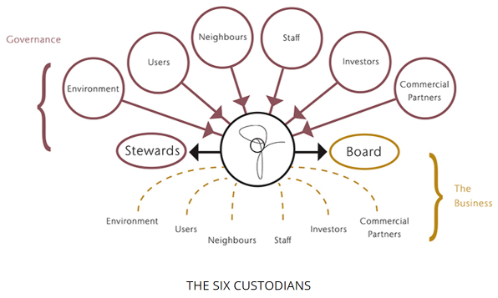

Slide 66
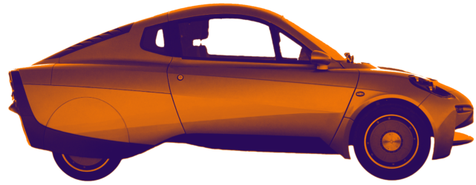
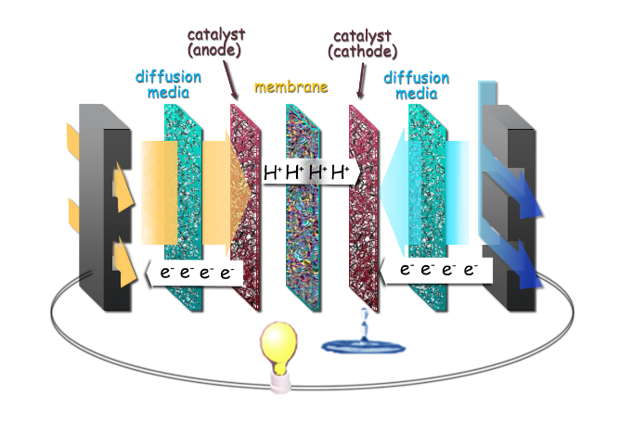
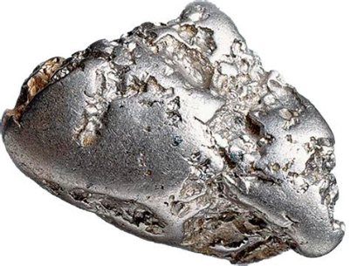
Riversimple Circularity Model
Mobility as a Service
Hydrogen Power as a Service
Hydrogen Catalysis as a Service
Platinum Catalyst as a Service

Slide 67
Riversimple Business Model
key partners JSR Micro SDC Design KS Composites Hydrogenics Cadonix Sevcon Embed Sagelok Vectayn Michelin Printed Motor Works Innovate UK Nice Vehicle Network Diffplug Swarm Manchester University Welsh Automotive Forum Sharein 40 Fires Foundation (?) | key activities R&D collaborative R&D open source development and design buy hydrigen cells as a service (pay per kilowatt) | customer value proposition ecologically sustainable personal transport as all-inclusive service (hydrogen powered car, fuel, service) | customer relationships mobility as a service interaction with customers through car interface or web aftersales care and support | customer groups green car buyers and users local authorities small commercial fleets car clubs
 |  |  | customer channels crowdfunding word of mouth publicity social media service centres
 | key resources small-scale manufacturing plants (5 000 cars per year) drivetrain IP car design open design philosophy | social impact mission elimination of the environmental impact of personal transport make car design available as open source for any small manufacturer to take up and tweak for free | community relationships through custodians | community stakeholders local communities (cities) users neighbours staff
 |  |  | social channels improved liveability in cities because of cleaner personal transport
ecosystem services raw materials land water energy | mission integration board of custodians (environment, users, neighbours, staff, investors, commercial partners) steward representing custodians and feeding custodian advice to the executive board | ecological impact mission mobility at zero cost to the planet | ecosystem channels reduced resource consumption because of MaaS model shift away from the use of fossile fuels reduces harm to the atmosphere wider adoption of hydrogen fuel cell designs will reinforce this development | ecosystem beneficiaries ecosphere atmosphere biophysical stocks
cost structure upfront R&D hydrogen cells as service fees manufacturing servicing, hydrogen |  | surplus streams does your business generate specific surpluses to invest surplus in expanding the operation to new locations shift to hydrogen reduces fossile fuel consumption revenue model reinforces re-use, resource saving philosophy | revenue streams current: grants up and running: maas fees (cover car, fuel, service) sale of service model (not sale of car)

Slide 68
Light Up the World: Network Value Map (For Profit)
social benefits
economic benefits
Cost of kerosene: $240 - $360/y
Cost of solar panel:
$360
Installation: $100
Maintenance: $17/y
villager’s children
village community
solar panel, upgrades
education
LUTW
villager
panel lease $50/y
electricity fee $10/mo
sales revenue from upgrades, gadgets (TV, equipment)
service fee,
commission
local maintenance
improved income
health benefits
increased
sales
training
panel maintenance
upgrade sales
gadget sales
village
technician
improved income

